Slide 1

AI in Business Tools, Technology & Demos Presented by Brian Byrne MSc

Slide 2


Introduction
Mr. Brian Byrne
MSc Electronic Engineering, B.Sc. Applied Science,
Diploma Financial Management,
Microsoft Certified Developer 16 Certifications so far, and counting!
25 years’ experience designing and building software for Pensions, finance, and telecoms sectors
Training in Machine Learning

Slide 3
Lecture in AI - Agenda
Overview of AI, Machine Learning and related concepts (25 mins)
Interactive Lab analysing California House Prices dataset(25 mins)
Application of AI in Business (25 mins)
Questions and Answers! (10-15 mins)

Slide 4
History of AI
Dartmouth Conference (1956):
The field of AI officially began with the Dartmouth Conference in 1956, organized by John McCarthy, Marvin Minsky, Nathaniel Rochester, and Claude Shannon. The conference coined the term "Artificial Intelligence" and set the ambitious goal of creating machines that could mimic human intelligence.
Early Symbolic AI (1950s-1960s):
During the 1950s and 1960s, researchers focused on symbolic AI, using rules and symbols to represent knowledge. Early AI programs, such as the Logic Theorist and the General Problem Solver, aimed to solve mathematical problems and demonstrate problem-solving abilities.
AI Winter (1970s-1980s):
The field faced a period of reduced funding and enthusiasm known as the "AI Winter" during the 1970s and 1980s. Initial optimism waned as early AI systems struggled to meet expectations, leading to skepticism and decreased investment in AI research.
Expert Systems (1980s):
In the 1980s, AI research experienced a resurgence with the development of expert systems. These systems, which emulated human expertise in specific domains, gained popularity. Examples include MYCIN, a medical diagnosis system, and DENDRAL, which analyzed mass spectrometry data for chemistry.
Rise of Machine Learning (1990s-2000s):
The 1990s and 2000s witnessed a shift towards machine learning approaches. Researchers began utilizing statistical techniques, neural networks, and algorithms that could learn patterns from data. Support Vector Machines (SVM) and neural network architectures like the Multilayer Perceptron gained prominence.
Deep Learning and AI Resurgence (2010s-Present):
The 2010s marked a significant resurgence in AI, driven by advancements in deep learning. Deep neural networks demonstrated remarkable performance in tasks such as image recognition, natural language processing, and game playing. Key developments include the rise of convolutional neural networks (CNNs) and the success of deep learning frameworks like TensorFlow and PyTorch.

Slide 5
NEW START – PROGRAMMING IN AI
AI is basically Programming 2.0 (next generation of programming)
Now we program computers to give ‘Artificial Intelligence’
But how ?
LOTS OF DATA
LOTS OF COMPUTE POWER – CLOUD COMPUTING
SOFTWARE FRAMEWORKS MAKE DESIGNING CODE EASIER
More Engineers available

Slide 6
QUESTION
How may students have use AI in their every day lives?
Describe your findings ?

Slide 7
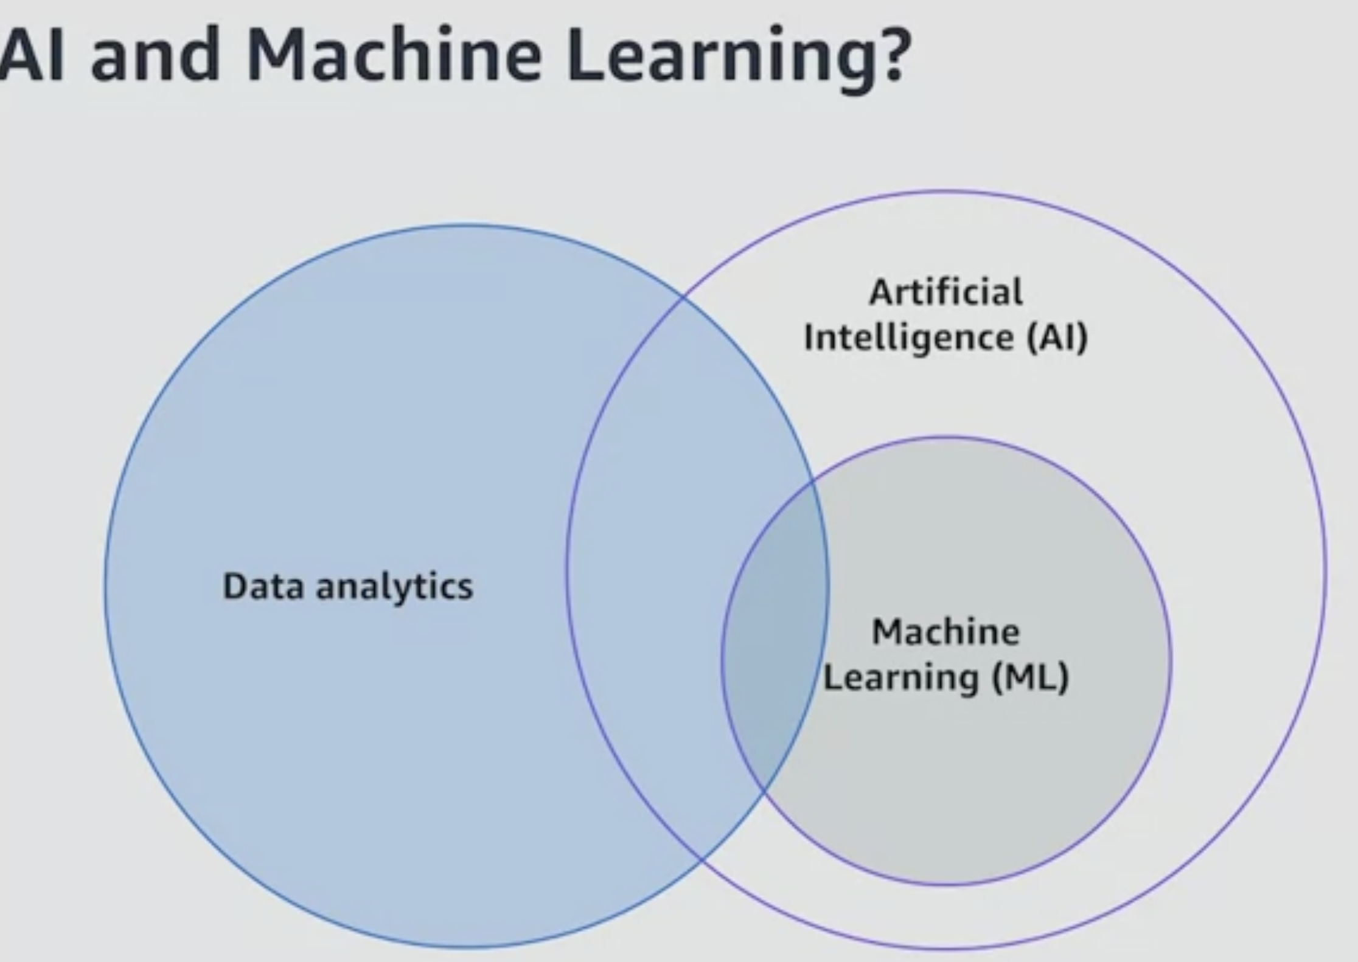
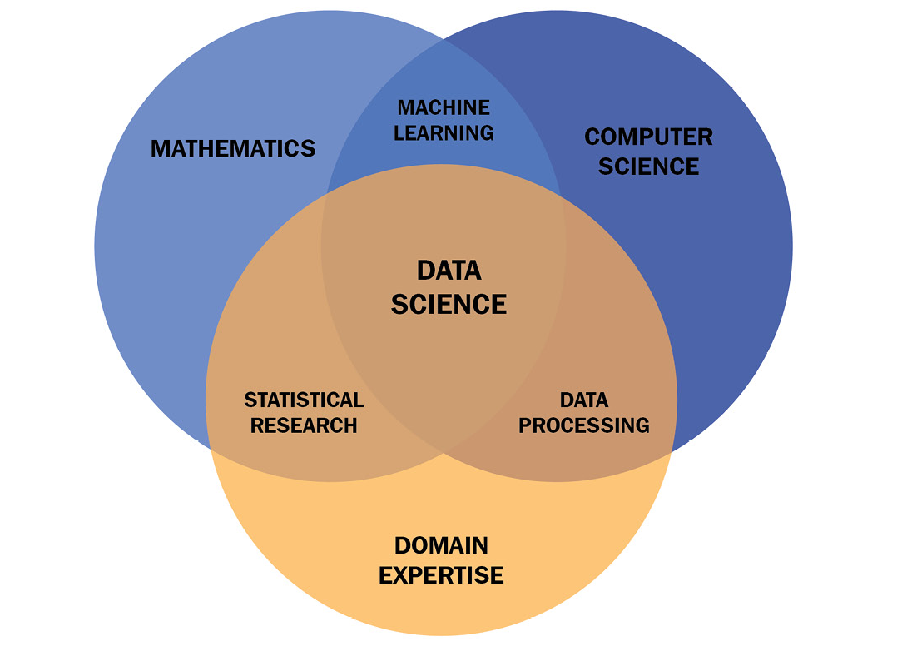
AI, Machine Learning + Data Science

Slide 8
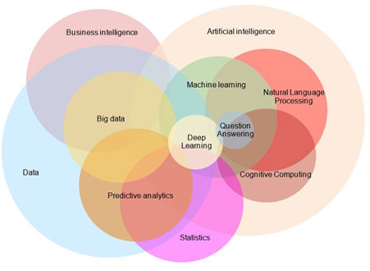
AI Related Disciplines
Statistics
Machine Learning
Big Data
Cognitive Computing
Natural Language Processing
Predictive Analytics
Business Intelligence

Slide 9
Artificial Intelligence
Artificial Intelligence (AI) refers to the simulation of human intelligence in machines that are programmed to think and learn like humans. The goal of artificial intelligence is to enable computers and machines to perform tasks that typically require human intelligence, such as
understanding natural language
recognizing patterns
solving problems
making decisions.

Slide 10
Machine Learning
What is Machine Learning
Machine Learning (ML) is a subfield of artificial intelligence (AI) that focuses on the development of algorithms and statistical models that enable computers to perform tasks without explicit programming. The primary goal of machine learning is to enable computers to learn from data and make predictions or decisions based on that learning.

Slide 11
Data Analytics
What is Data Analytics –
Data analytics, in the context of Artificial Intelligence (AI), refers to the process of examining and interpreting large volumes of data to extract meaningful insights, patterns, and knowledge. Data analytics serves as a foundational element for many AI applications, providing the raw material necessary for training machine learning models and making informed decisions.
Why we need Data Analytics ?
Data analytics provides the foundation for AI by supplying the data needed to train models, generating insights to drive decision-making, and facilitating continuous improvement through monitoring and feedback loops. The synergy between data analytics and AI enables organizations to leverage the power of data for smarter, more informed decision-making and problem-solving.
Examples include targeted banking products, Personalized entertainment choices etc.

Slide 12
Key concepts within AI
Machine Learning (ML): A subset of AI that involves the development of algorithms and statistical models that enable computers to improve their performance on a task over time through experience. This learning process is often data-driven. Instead of being explicitly programmed to perform a task, a machine learning model learns patterns and relationships from examples.
Deep Learning: A specialized field of machine learning inspired by the structure and function of the human brain's neural networks. Deep learning involves training artificial neural networks on large datasets to recognize patterns and make decisions.
Natural Language Processing (NLP): The ability of machines to understand, interpret, and generate human language. NLP is essential for applications like language translation, chatbots, and sentiment analysis.
Computer Vision: Enabling machines to interpret and make decisions based on visual data. Computer vision is used in image and video recognition, facial recognition, object detection, and autonomous vehicles.
Robotics: Combining AI with physical machines to create robots that can perform tasks in the real world. This includes industrial robots, drones, and robotic process automation.
Expert Systems: Rule-based systems that emulate the decision-making abilities of a human expert in a particular domain. They use a knowledge base of human expertise and an inference engine to draw conclusions.

Slide 13
Why is AI Popular Now ?
Advancements in Technology:
Breakthroughs in hardware, especially the development of Graphics Processing Units (GPUs) and specialized hardware for AI tasks, have significantly increased computational power. This has enabled the training of complex AI models, particularly in deep learning.
Big Data Availability:
The proliferation of digital data has provided a massive amount of information for training AI models. The availability of vast datasets is crucial for machine learning algorithms to learn and generalize patterns effectively.
Open Source and Collaboration:
Many AI tools and frameworks, including TensorFlow and PyTorch, are open source. This has facilitated collaboration and knowledge-sharing within the AI community, accelerating research and development.
Algorithmic Advances:
There have been significant advancements in AI algorithms, particularly in the field of deep learning. Neural networks with many layers (deep neural networks) have proven effective in tasks such as image recognition, natural language processing, and more.
Cloud Computing:
The availability of cloud computing resources allows researchers and businesses to access powerful computing infrastructure without the need for large upfront investments. Cloud platforms like AWS, Google Cloud, and Azure offer scalable solutions for AI development and deployment.
Notes:
Test

Slide 14
Example Business Problem and AI Models
Customer Churn Prediction:
Business Problem: Identifying customers who are likely to churn (cancel their subscription or leave a service) is crucial for retention strategies.
AI Model: Classification models, such as logistic regression or decision trees, can be used to predict whether a customer is likely to churn based on historical usage patterns, customer interactions, and feedback.
Demand Forecasting:
Business Problem: Optimizing inventory and supply chain management by accurately predicting future demand for products or services.
AI Model: Time series forecasting models, like ARIMA (AutoRegressive Integrated Moving Average) or machine learning models like Random Forests, can analyze historical sales data to predict future demand and optimize inventory levels.
Fraud Detection:
Business Problem: Identifying fraudulent activities, transactions, or behavior to mitigate financial losses and maintain trust.
AI Model: Anomaly detection models, supervised machine learning models, or deep learning models can analyze patterns and deviations from normal behavior to identify potential fraud in real-time.
Personalized Marketing Campaigns:
Business Problem: Delivering targeted and personalized marketing messages to enhance customer engagement and increase conversion rates.
AI Model: Recommendation systems, utilizing collaborative filtering or content-based filtering, can analyze customer preferences and behaviors to suggest personalized products, services, or content.
Sentiment Analysis:
Business Problem: Understanding customer sentiment expressed in reviews, feedback, and social media to improve products or services.
AI Model: Natural Language Processing (NLP) models, such as sentiment analysis using machine learning algorithms or deep learning models (like Recurrent Neural Networks), can analyze textual data to determine sentiment polarity (positive, negative, neutral).
Employee Attrition Prediction:
Business Problem: Identifying factors contributing to employee attrition and predicting which employees are likely to leave.
AI Model: Classification models, like logistic regression or decision trees, can analyze employee data, including performance metrics, job satisfaction, and engagement, to predict the likelihood of an employee leaving the organization.

Slide 15
Why is AI Popular Now ?
Increased Investment:
There has been a surge in investment from both public and private sectors in AI research and development. This funding has fueled innovation and the creation of new AI technologies and applications.
Practical Applications and Industry Adoption:
AI has demonstrated its value in various practical applications across industries, including healthcare, finance, e-commerce, and more. As organizations witness the tangible benefits of AI, there is a growing interest in adopting these technologies.
Rise of Big Tech Companies:
Large technology companies, such as Google, Facebook, Amazon, and Microsoft, have heavily invested in AI research and development. Their influence and resources have played a significant role in advancing the field.
Democratization of AI:
The accessibility of AI tools and platforms to a broader audience has democratized AI development. As a result, even small startups and individual developers can experiment with and implement AI solutions.
Increased Awareness and Education:
There is a growing awareness and understanding of AI among the general public. Educational initiatives, online courses, and workshops have made AI more accessible, fostering a broader interest and engagement in the field.
Integration with Other Technologies:
AI is increasingly integrated with other emerging technologies, such as the Internet of Things (IoT), blockchain, and 5G. This integration enhances the capabilities of AI and opens up new possibilities for innovation.

Slide 16
QUESTION
Has anyone heard of ‘Data Analytics’ ? What is it ?

Slide 17
How data analytics relates to AI:
Data Preparation:
Data analytics involves collecting, cleaning, and preparing data for analysis. This includes handling missing values, removing outliers, and structuring the data in a format suitable for feeding into machine learning algorithms.
Feature Engineering:
In the context of AI, feature engineering involves selecting and transforming relevant features (variables) from the dataset to improve the performance of machine learning models. Data analytics is crucial for identifying these features and understanding their significance.
Training Data for Machine Learning:
AI models, particularly machine learning models, require substantial amounts of labeled data for training. Data analytics is instrumental in selecting and preparing this training data, ensuring that the model learns patterns and relationships effectively.
Descriptive Analytics:
Descriptive analytics involves summarizing historical data to provide insights into what has happened in the past. In the context of AI, this historical data is often used to understand trends, identify patterns, and gain a deeper understanding of the problem domain.
Predictive Analytics:
Predictive analytics uses historical data and statistical algorithms to make predictions about future events. In AI, predictive analytics is foundational to many machine learning applications, such as forecasting, recommendation systems, and predictive maintenance.

Slide 18
Data Analytics
Prescriptive Analytics:
Prescriptive analytics goes beyond predicting outcomes and provides recommendations for actions to optimize results. In AI, prescriptive analytics can be applied to decision-making processes, suggesting optimal strategies based on data-driven insights.
Real-time Analytics:
Real-time analytics involves processing and analyzing data as it is generated, allowing for immediate insights and decisions. In AI applications, real-time analytics can enhance the responsiveness of systems, such as in fraud detection or dynamic pricing.
Monitoring and Evaluation:
After deploying AI models, ongoing data analytics is essential for monitoring model performance, detecting drift in data distributions, and ensuring that the model continues to make accurate predictions over time.
Feedback Loops:
Data analytics is critical for creating feedback loops in AI systems. By analyzing the outcomes of AI applications, organizations can iteratively improve models, enhance algorithms, and optimize decision-making processes.
Interpretability and Explainability:
Understanding the results of AI models is essential for building trust and ensuring ethical use. Data analytics plays a role in interpreting and explaining the outcomes of complex machine learning models, contributing to transparency and accountability.

Slide 19
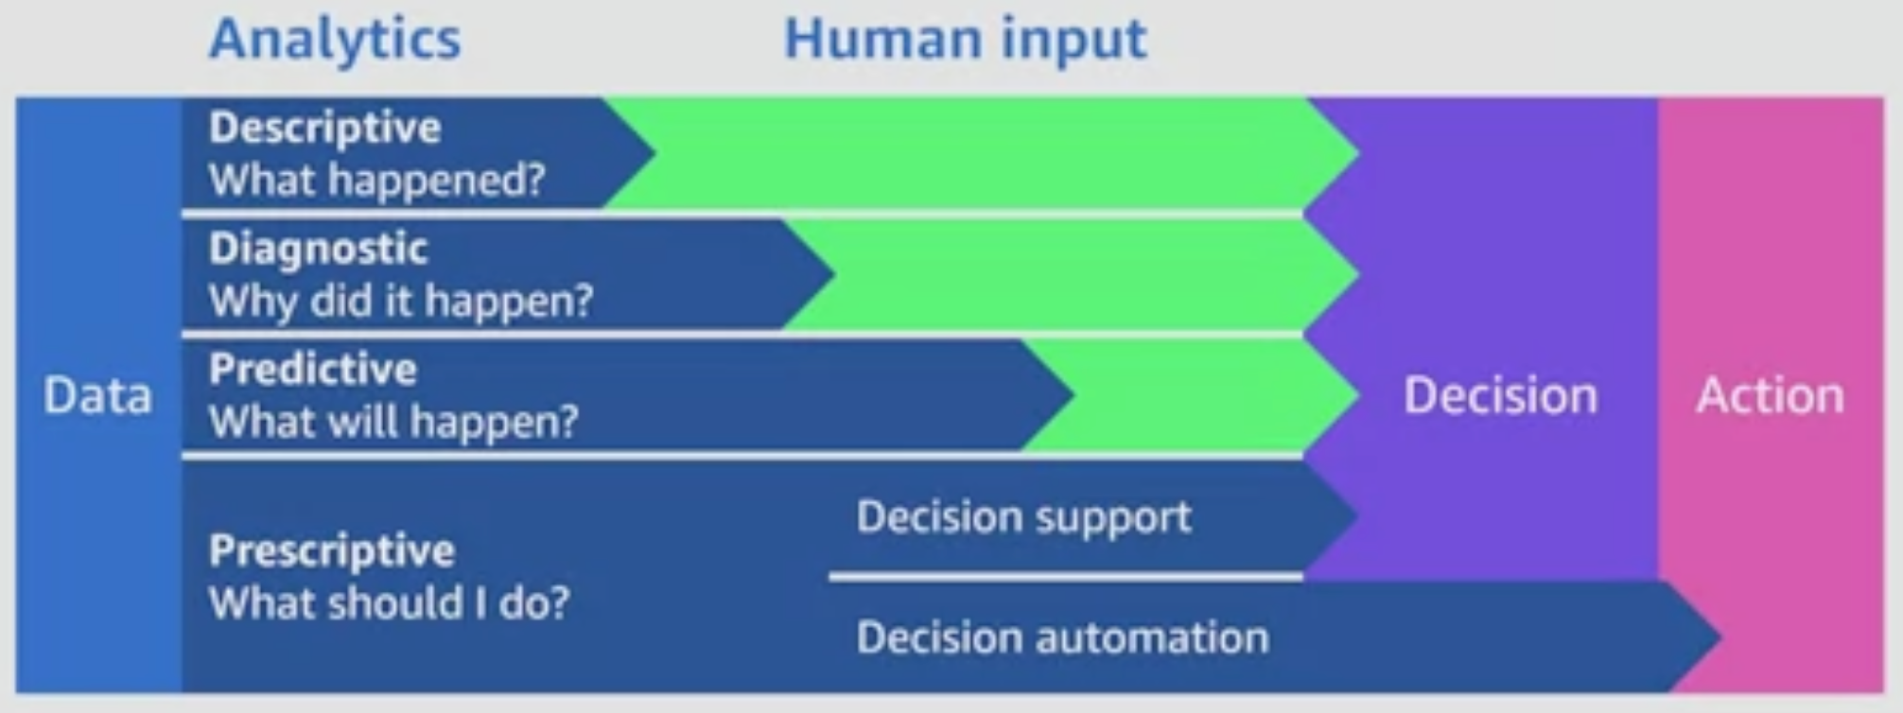
Analytics

Slide 20
Machine Learning – Key Concepts
Data:
Machine learning systems learn from data. This data can include a wide range of information, such as text, images, numerical values, or any other form of structured or unstructured data.
Features:
Features are the individual measurable properties or characteristics of the data that the machine learning model uses to make predictions or decisions.
Labels or Targets:
In supervised learning, the machine learning model is trained on a dataset that includes both input data and corresponding labels or targets. Labels are the outcomes or values that the model aims to predict.
Training:
During the training phase, the machine learning model is exposed to a labelled dataset, and it learns to identify patterns and relationships within the data. The model adjusts its parameters to minimize the difference between its predictions and the actual labels.
Algorithms:
Machine learning algorithms are mathematical models that define how a machine learning system learns from data. Different algorithms are suited to different types of tasks, such as regression, classification, clustering, or reinforcement learning.
Types of Machine Learning:
Supervised Learning: The model is trained on a labeled dataset, and it learns to make predictions or classifications based on input features.
Unsupervised Learning: The model is given unlabeled data and must find patterns or relationships without explicit guidance.
Reinforcement Learning: The model learns by interacting with an environment and receiving feedback in the form of rewards or penalties.
Evaluation:
After training, the model is evaluated on new, unseen data to assess its performance. Common metrics include accuracy, precision, recall, F1 score for classification tasks, and mean squared error for regression tasks.
Prediction or Inference:
Once trained, the machine learning model can make predictions or decisions on new, unseen data. This is the phase where the model is deployed for practical use.

Slide 21
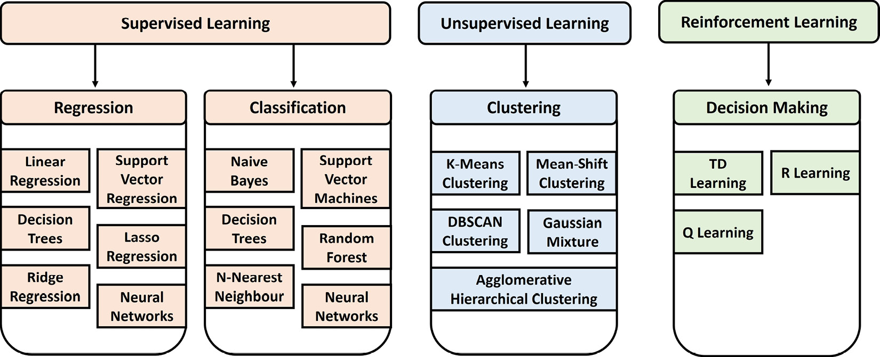
ML Algorithms

Slide 22
Supervised vs Unsupervised Learning
Supervised learning:
In supervised learning, models are trained with a so-called labelled dataset. That means besides knowing the input for the required algorithm, we also know the required output. This type of learning is split into two groups of problems—namely, classification problems and regression problems. Classification works with discrete results, where the output is a class or group, while regression works with continuous results, where the output would be a certain value. Examples of classification would be identifying fraud in money transactions or doing object detection in images. Examples of regression would be forecasting prices for houses or the stock market or predicting population growth. It is important to understand that this type of learning requires labels, which often results in the tedious task of labelling the whole dataset.
Unsupervised learning:
In unsupervised learning, models are trained on unlabelled data. This is basically self-organized learning to find patterns in data, referred to as clustering. Examples of this would be the filtering of spam emails in an inbox or the recommendation of movies or clothing a person might like to watch or purchase. Often, the learning algorithms are used in a real-time scenario where the data needs to be processed directly. The beauty of this type of learning is that we do not have to label the dataset.

Slide 23
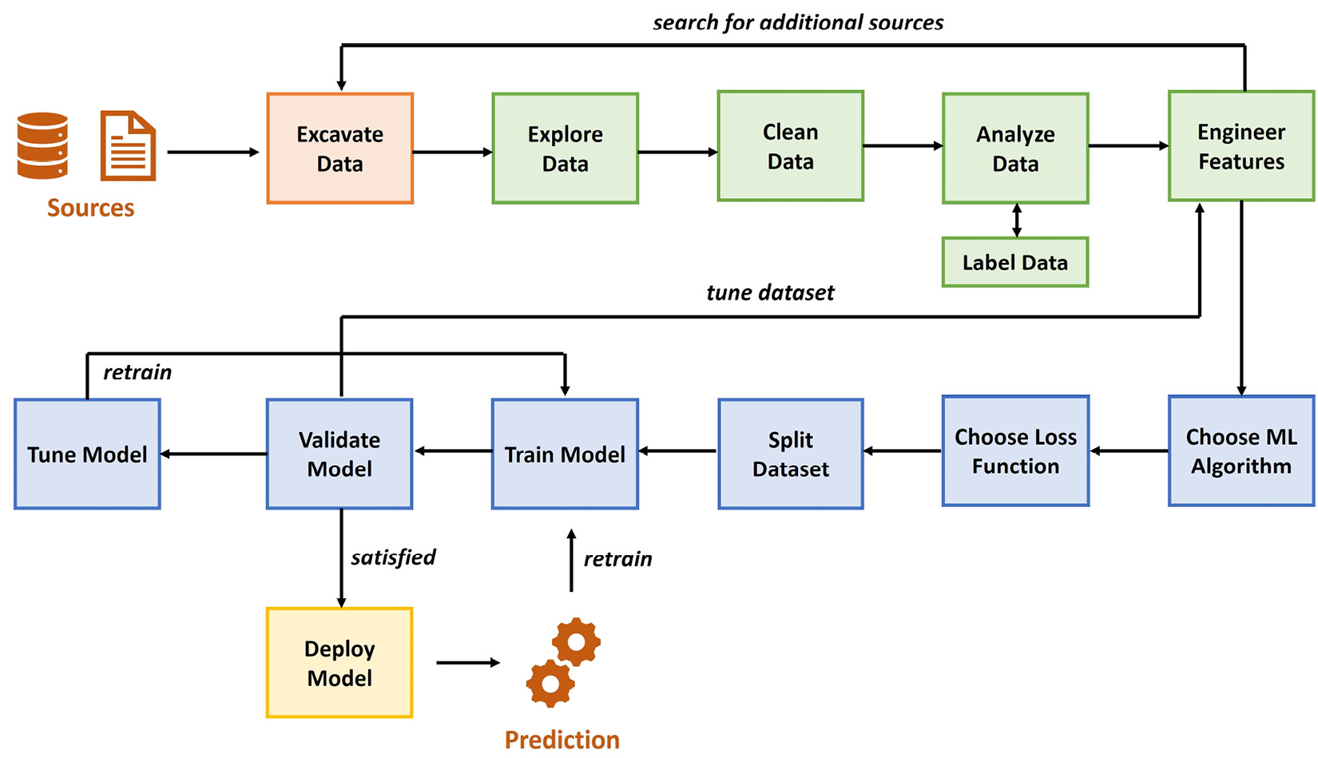
End to End ML Process

Slide 24
QUESTION
WHERE IS THE MOST TIME CONSUMING WORK IN THE PRECEDING DIAGRAM ?

Slide 25
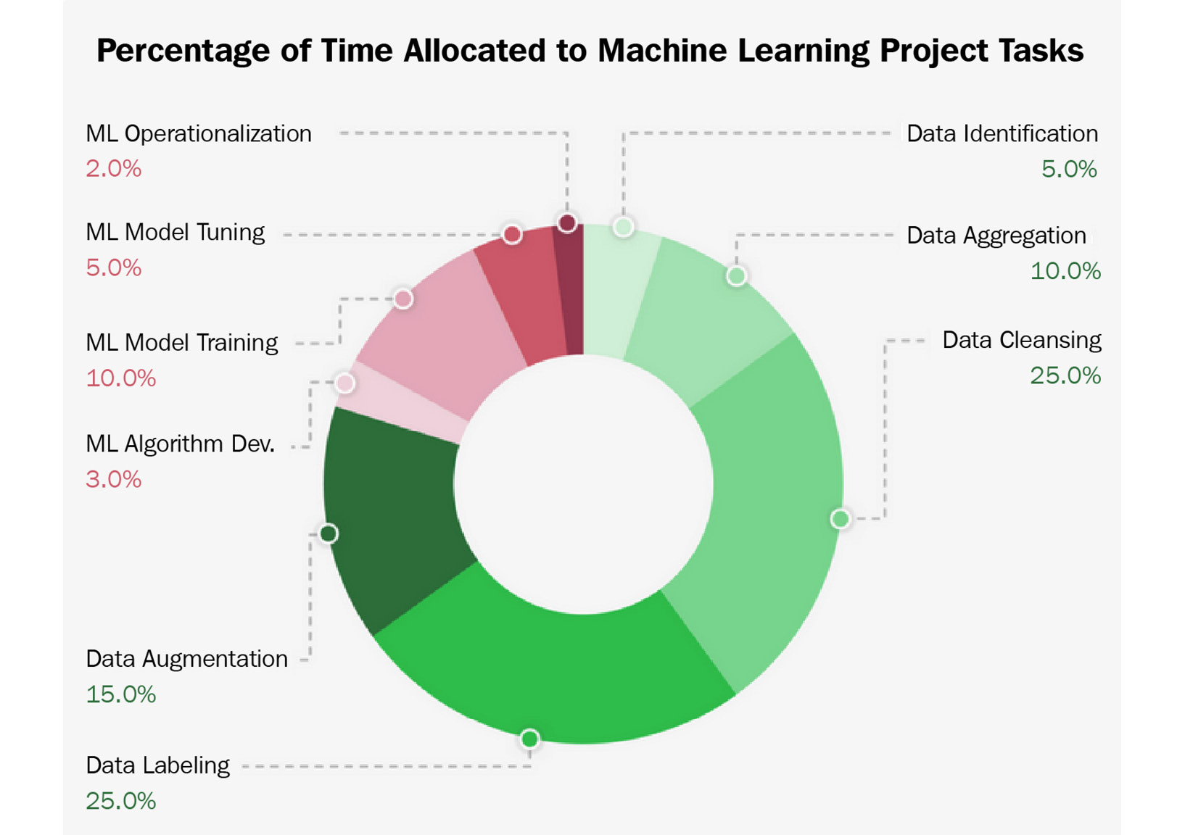
ML Time Invested
You might be surprised that only 20% of the time, you will work on something that has to do with the actual training and deployment of ML models.

Slide 26
QUESTION
WRITE A BUSINESS PROBLEM DOWN THEY WOULD LIKE AI TO SOLVE. ? …
…Will select some examples later...

Slide 27
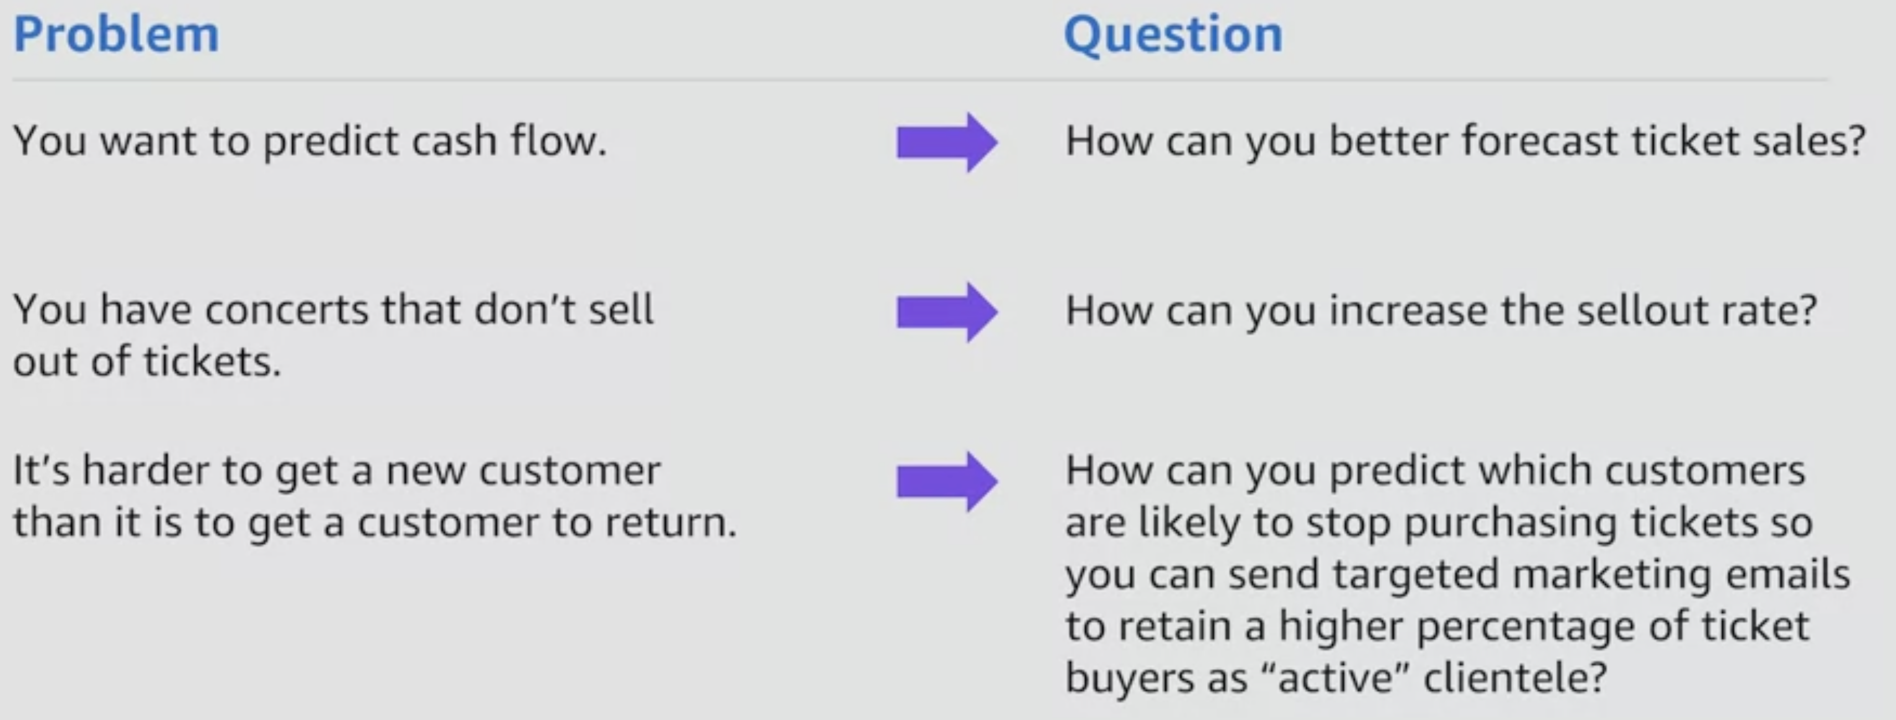
Example business problems

Slide 28
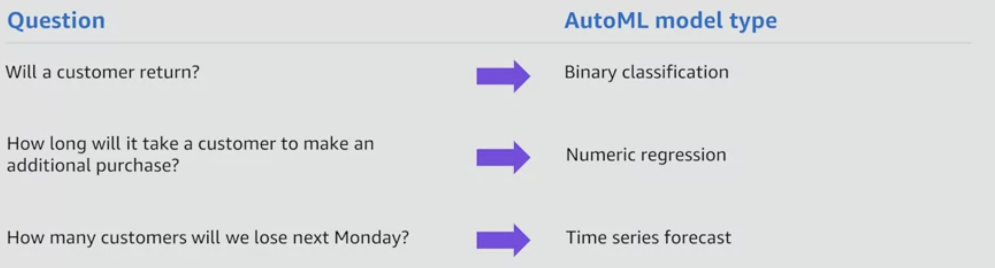
Match a Business Question to Model type

Slide 29
QUESTION
WHAT STEPS DO YOU THINK ARE INVOLVED IN GENERATING AN ‘ARTIFICIAL INTELLIGENT’ SOLUTION FOR BUSINESS ?

Slide 30
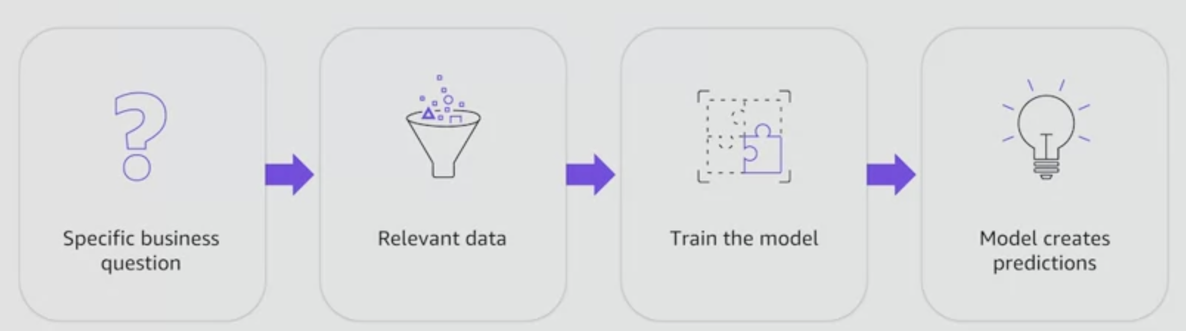
Sequence of steps for AI

Slide 31
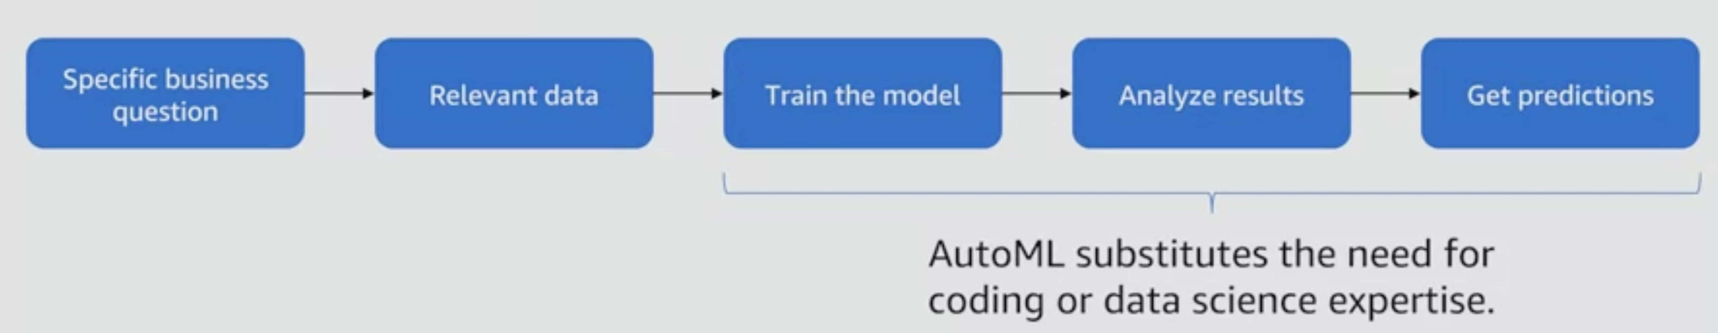
Processing steps 2

Slide 32
AI WORKFLOW - 1
1. Problem Definition:
Identify the Problem: Clearly define the problem that AI is intended to solve. This could range from automating a specific task to making predictions or recommendations.
Set Objectives: Establish the goals and desired outcomes of the AI system. What are the key performance indicators (KPIs) for success?
2. Data Collection:
Define Data Requirements: Identify the type and amount of data needed for the AI project. This includes specifying the features and labels for supervised learning tasks.
Acquire Data: Collect or obtain the necessary data from various sources. This may involve data scraping, API integration, or accessing existing datasets.
3. Data Preparation:
Data Cleaning: Handle missing values, outliers, and errors in the dataset.
Data Transformation: Normalize, scale, or transform features to ensure they are suitable for the chosen algorithms.
Split Data: Divide the dataset into training, validation, and test sets for model evaluation.
4. Exploratory Data Analysis (EDA):
Statistical Analysis: Examine descriptive statistics of the dataset.
Visual Exploration: Create visualizations to understand the distribution and relationships within the data.
Feature Engineering: Identify relevant features and create new ones if needed.
5. Model Development:
Select Model Architecture: Choose the type of model based on the nature of the problem (e.g., regression, classification, clustering).
Training: Use the training dataset to train the model, adjusting parameters to optimize performance.
Validation: Evaluate the model's performance on a separate validation dataset to fine-tune parameters and prevent overfitting.

Slide 33
AI WORKFLOW - 2
6. Model Evaluation:
Testing: Assess the model's performance on the test dataset to ensure it generalizes well to new, unseen data.
Metrics: Use appropriate evaluation metrics (accuracy, precision, recall, F1 score, etc.) to measure the model's effectiveness.
7. Deployment:
Integration: Integrate the trained model into the target environment or system.
Monitoring: Implement monitoring systems to track the model's performance and detect potential issues.
Scalability: Ensure that the deployed model can scale to handle different workloads.
8. Feedback and Iteration:
Gather Feedback: Collect feedback from end-users and stakeholders to identify areas for improvement.
Model Refinement: Based on feedback and performance metrics, refine the model, update parameters, or consider using additional data.
9. Maintenance and Monitoring:
Continuous Monitoring: Regularly monitor the deployed model to ensure it remains effective and does not degrade over time.
Updates and Maintenance: Implement updates or retraining as needed to address changing data distributions or business requirements.
10. Ethical Considerations:
Bias and Fairness: Regularly assess the model for bias and fairness issues.
Transparency: Communicate the model's behavior and limitations transparently to users and stakeholders.
Privacy: Ensure that data privacy and security considerations are addressed throughout the workflow.

Slide 34
Some AI Concepts
Sourcing Data
Exploratory Data Analysis
Cleaning Data
Pre-processing Techniques (Normalization, Scaling, Encoding)
Feature Engineering
Model Selection and Training
Model Validation and Evaluation (Metrics)
Model deployment and monitoring

Slide 35
Data Sources
In-house data sources:
If you are running a project in or with a company, the first point to look is internally.
Open data sources:
Use freely available datasets. Advantages of those are that they are typically gigantic in size. Eg: European Union (EU) Open Data Portal (https://data.europa.eu/en)
Data seller (data as a service, or DaaS)
Buy data from a data seller, either by purchasing an existing dataset or by requesting the creation of one. Eg: Amazon Data Exchange
(https://aws.amazon.com/data-exchange/)

Slide 36
QUESTION
Why would we clean the data we have just sourced.?
What sort of problems might we encounter in the data ?

Slide 37
Cleaning Data
Duplicates:
Through mistakes in copying data or due to a combination of different data sources, you might find duplicate samples. Typically, copies can be deleted. Just make sure that these are not two different samples that look the same.
Irrelevant information:
In most cases, you will have datasets with a lot of different features, some of which will be completely unnecessary for your project. The obvious ones you should just remove in the beginning; others you will be able to remove later after analyzing the data further.
Structural errors:
This refers to the values you can see in the samples. You might run into different entries with the same meaning (such as US and United States) or simply typos. These should be standardized or cleaned up. A good way to do this is by visualizing all available values of a feature.
Anomalies (outliers):
This refers to very unlikely values for which you need to decide whether they are errors or actually true. This is typically done after analyzing the data when you know the distribution of a feature.
Missing values:
This refers to cells in your data that are either blank or have some generic value in them, such as NA or NaN. There are different ways to rectify this besides deleting entire samples. It is also prudent to wait until you have more insight from analyzing the data, as you might see better ways to replace them.

Slide 38
Analyze Data
Apply understanding of statistics to get insights into features and labels for the data. Including:
calculating statistical properties for each feature
visualizing features
finding correlated features
measuring feature importance, which calculates the impact of a feature on the label, also referred to as the target variable

Slide 39
Exploratory Data Analysis
Understand the Data:
Description: Familiarize yourself with the dataset's structure, features, and overall composition.
Actions: Examine the first few rows of the dataset. Check for data types, missing values, and unique values.
Summary Statistics:
Description: Compute descriptive statistics to summarize the central tendency, dispersion, and shape of the dataset's distribution.
Actions: Calculate mean, median, mode, minimum, maximum, and quartiles. Use tools like describe() in pandas for a quick overview.
Data Visualization:
Description: Create visualizations to uncover patterns, trends, and relationships in the data.
Actions: Use histograms, box plots, and density plots for distribution analysis. Create scatter plots to visualize relationships between variables. Utilize pair plots or correlation matrices to explore feature relationships.
Handle Missing Data:
Description: Address missing values to ensure a complete and accurate dataset.
Actions: Identify and quantify missing values. Decide on appropriate strategies (imputation, removal, or handling as a separate category).
Data Cleaning:
Description: Clean the data by addressing inconsistencies, outliers, and errors.
Actions: Address outliers through transformations or removal. Correct errors and inconsistencies in the data.
Feature Engineering:: Create new features or modify existing ones to enhance model performance.
Actions: Create interaction terms or polynomial features. Extract relevant information from existing features.
Univariate Analysis:: Examine individual features in isolation to understand their distributions.
Actions: Visualize and analyze the distribution of each feature using histograms, kernel density plots, or bar charts.
Bivariate Analysis:: Explore relationships between pairs of features to identify correlations or dependencies. Actions: Create scatter plots, heatmaps, or pair plots for visualizing relationships.
Outlier Detection:
Description: Identify and handle outliers that may skew the analysis or modeling process.
Actions: Visualize outliers using box plots or scatter plots. Consider statistical methods or clustering techniques for outlier detection.
Explore Time Series Data (if applicable):: If dealing with time series data, examine temporal patterns and trends.
Actions: Plot time series data. Conduct time-based analysis, such as seasonality or trend detection.
Statistical Testing (if applicable):: Perform statistical tests to validate hypotheses or assess the significance of relationships.
Actions: Conduct t-tests, ANOVA, or other relevant statistical tests based on the nature of the data.
Document Findings:: Document key observations, insights, and potential challenges discovered during the EDA process.
Actions: Summarize key findings in a report or Jupyter notebook. Provide visualizations and explanations to support observations.

Slide 40
Preprocessing Data
1. Data Cleaning:
Handling Missing Values:
Removing instances with missing values.
Imputing missing values based on statistical measures (mean, median, mode).
Handling Outliers: Identifying and either removing or transforming outliers.
2. Data Transformation:
Normalization: Scaling features to a standard range (e.g., 0 to 1).
Standardization: Transforming features to have a mean of 0 and a standard deviation of 1.
Log Transformation: Applying logarithmic transformations to handle skewed data distributions.
Box-Cox Transformation: A family of power transformations to stabilize variance and make data more Gaussian-like.
3. Handling Categorical Data:
One-Hot Encoding: Creating binary columns for each category.
Label Encoding: Assigning a unique numerical label to each category.
4. Feature Engineering:
Creating Interaction Terms: Combining existing features to capture interactions.
Binning: Grouping continuous variables into bins or categories.
Polynomial Features: Introducing polynomial terms to capture non-linear relationships.
5. Dealing with Imbalanced Data:
Resampling: Over-sampling minority class or under-sampling majority class.
Synthetic Data Generation: Creating synthetic samples for the minority class using techniques like SMOTE (Synthetic Minority Over-sampling Technique).
6. Handling Time Series Data:
Resampling: Aggregating or interpolating data to a different time frequency.
Lag Features: Introducing lagged versions of the target variable or other features.
7. Text Data Preprocessing:
Tokenization: Breaking text into individual words or phrases (tokens).
Stopword Removal: Removing common words that do not contribute much to the meaning.
Stemming and Lemmatization: Reducing words to their base or root form.
8. Handling Noisy Data:
Smoothing: Applying filters or algorithms to reduce noise.
Anomaly Detection: Identifying and handling data points that deviate significantly from the norm.
9. Handling Multicollinearity:
VIF (Variance Inflation Factor):Identifying and removing highly correlated features.
10. Data Splitting:
Train-Test Split: Dividing the dataset into training and testing sets for model evaluation.

Slide 41
Model Training Algorithms
Supervised Learning:
Description: In supervised learning, the algorithm is trained on a labeled dataset, where each input is associated with the correct output. The goal is to learn a mapping from inputs to outputs.
Applications: Classification (e.g., spam detection), Regression (e.g., predicting house prices).
Unsupervised Learning:
Description: Unsupervised learning involves training on an unlabeled dataset, and the algorithm must find patterns or relationships within the data without explicit guidance.
Applications: Clustering (e.g., customer segmentation), Dimensionality reduction (e.g., Principal Component Analysis).
Semi-Supervised Learning:
Description: A combination of supervised and unsupervised learning, where the model is trained on a dataset with both labeled and unlabeled examples.
Applications: Utilized when obtaining a fully labeled dataset is expensive or time-consuming.
Reinforcement Learning:
Description: In reinforcement learning, an agent learns by interacting with an environment. The agent receives feedback in the form of rewards or penalties based on the actions it takes.
Applications: Game playing (e.g., AlphaGo), Robotics, Autonomous systems.
Deep Learning:
Description: Deep learning involves the use of artificial neural networks with multiple layers (deep neural networks). These networks can automatically learn hierarchical representations of data.
Applications: Image and speech recognition, Natural language processing, Computer vision.
Decision Trees:
Description: Decision trees recursively split the data based on features to make decisions or predictions. Each split is determined by choosing the feature that provides the best information gain or Gini impurity reduction.
Applications: Classification, Regression.

Slide 42
Model Training Algorithms
Random Forest:
Description: A Random Forest is an ensemble learning method that constructs a multitude of decision trees at training time and outputs the class that is the mode of the classes (classification) or the mean prediction (regression) of the individual trees.
Applications: Classification, Regression.
Support Vector Machines (SVM):
Description: SVMs are supervised learning models that analyze data for classification and regression analysis. They find a hyperplane that best separates data into classes.
Applications: Classification, Regression.
K-Nearest Neighbors (KNN):
Description: KNN is a simple, instance-based learning algorithm that classifies new instances based on the majority class of their k nearest neighbors.
Applications: Classification, Regression.
Neural Networks:
Description: Neural networks are composed of interconnected nodes (neurons) organized in layers. Deep neural networks have multiple hidden layers and are capable of learning complex representations.
Applications: Image and speech recognition, Natural language processing.
Gradient Boosting:
Description: Gradient boosting is an ensemble learning method where weak models (typically decision trees) are trained sequentially, with each model correcting errors made by the previous one.
Applications: Classification, Regression.

Slide 43
Steps for training an ML Model
Define your ML task: First, we need to define the ML task we are facing, which most of the time is defined by the business decision behind your use case. Depending on the amount of labeled data, you can choose between unsupervised and supervised learning methods, as well as many other subcategories.
Pick a suitable model: Pick a suitable model for the chosen ML task. This might be a logistical regression, a gradient-boosted ensemble tree, or a DNN,just to name a few popular ML model choices. The choice is mainly dependent on the training (or production) infrastructure (such as Python, R, Julia, C, and so on) and the shape and type of the data.
Pick or implement a loss function and an optimizer: During the data experimentation phase, you should have already come up with a strategy on how to test your model performance. Hence, you should have picked a data split, loss function, and optimizer already. If you have not done so, you should at this point evaluate what you want to measure and optimize.
Pick a dataset split: Splitting your data into different sets—namely, training, validation, and test sets—gives you additional insights into the performance of your training and optimization process and helps you to avoid overfitting your model to your training data.
Train a simple model using cross-validation: When all the preceding choices are made, you can go ahead and train your ML model. Optimally, this is done as cross-validation on a training and validation set, without leaking training data into validation. After training a baseline model, it's time to interpret the error metric of the validation runs. Does it make sense? Is it as high or low as expected? Is it (hopefully) better than random and better than always predicting the most popular target?
Tune the model: Finally, you can either tune the outcome of the model by working with the so-called hyperparameters of a model, do model stacking or other advanced methods, or you might have to go back to the initial data and work on that before training the model again.

Slide 44
Model Issues
Overfitting: This occurs when a model learns the training data too well and fails to generalize to new data. Overfitting can lead to poor performance on unseen data.
Underfitting: This occurs when a model is too simple and does not capture the underlying patterns in the data. Underfitting can also lead to poor performance on both training and unseen data.
Bias: This occurs when a model is systematically biased towards a particular group or outcome. Bias can lead to unfair or inaccurate predictions.
Noise: This occurs when the data is corrupted or contains errors. Noise can make it difficult for a model to learn the true underlying patterns in the data.
High dimensionality: This occurs when the data has a large number of features. High dimensionality can make it difficult for a model to learn the true relationships between the features.
Missing values: This occurs when some of the data points are missing values for one or more features. Missing values can make it difficult for a model to learn the true underlying patterns in the data.
Imbalanced data: This occurs when the data has a disproportionate number of data points from one or more classes. Imbalanced data can make it difficult for a model to learn to classify the minority class.
Concept drift: This occurs when the underlying patterns in the data change over time. Concept drift can make a model's performance degrade over time.

Slide 45
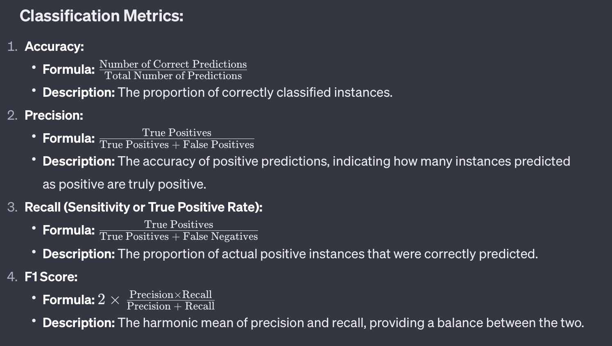
Key Metrics in AI - Classification

Slide 46
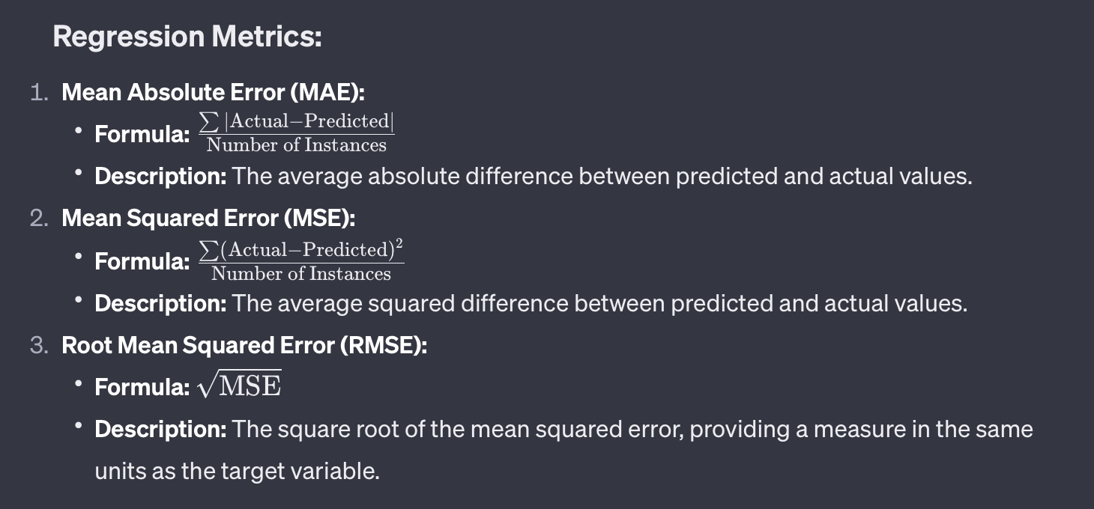
Key Metrics - Regression

Slide 47
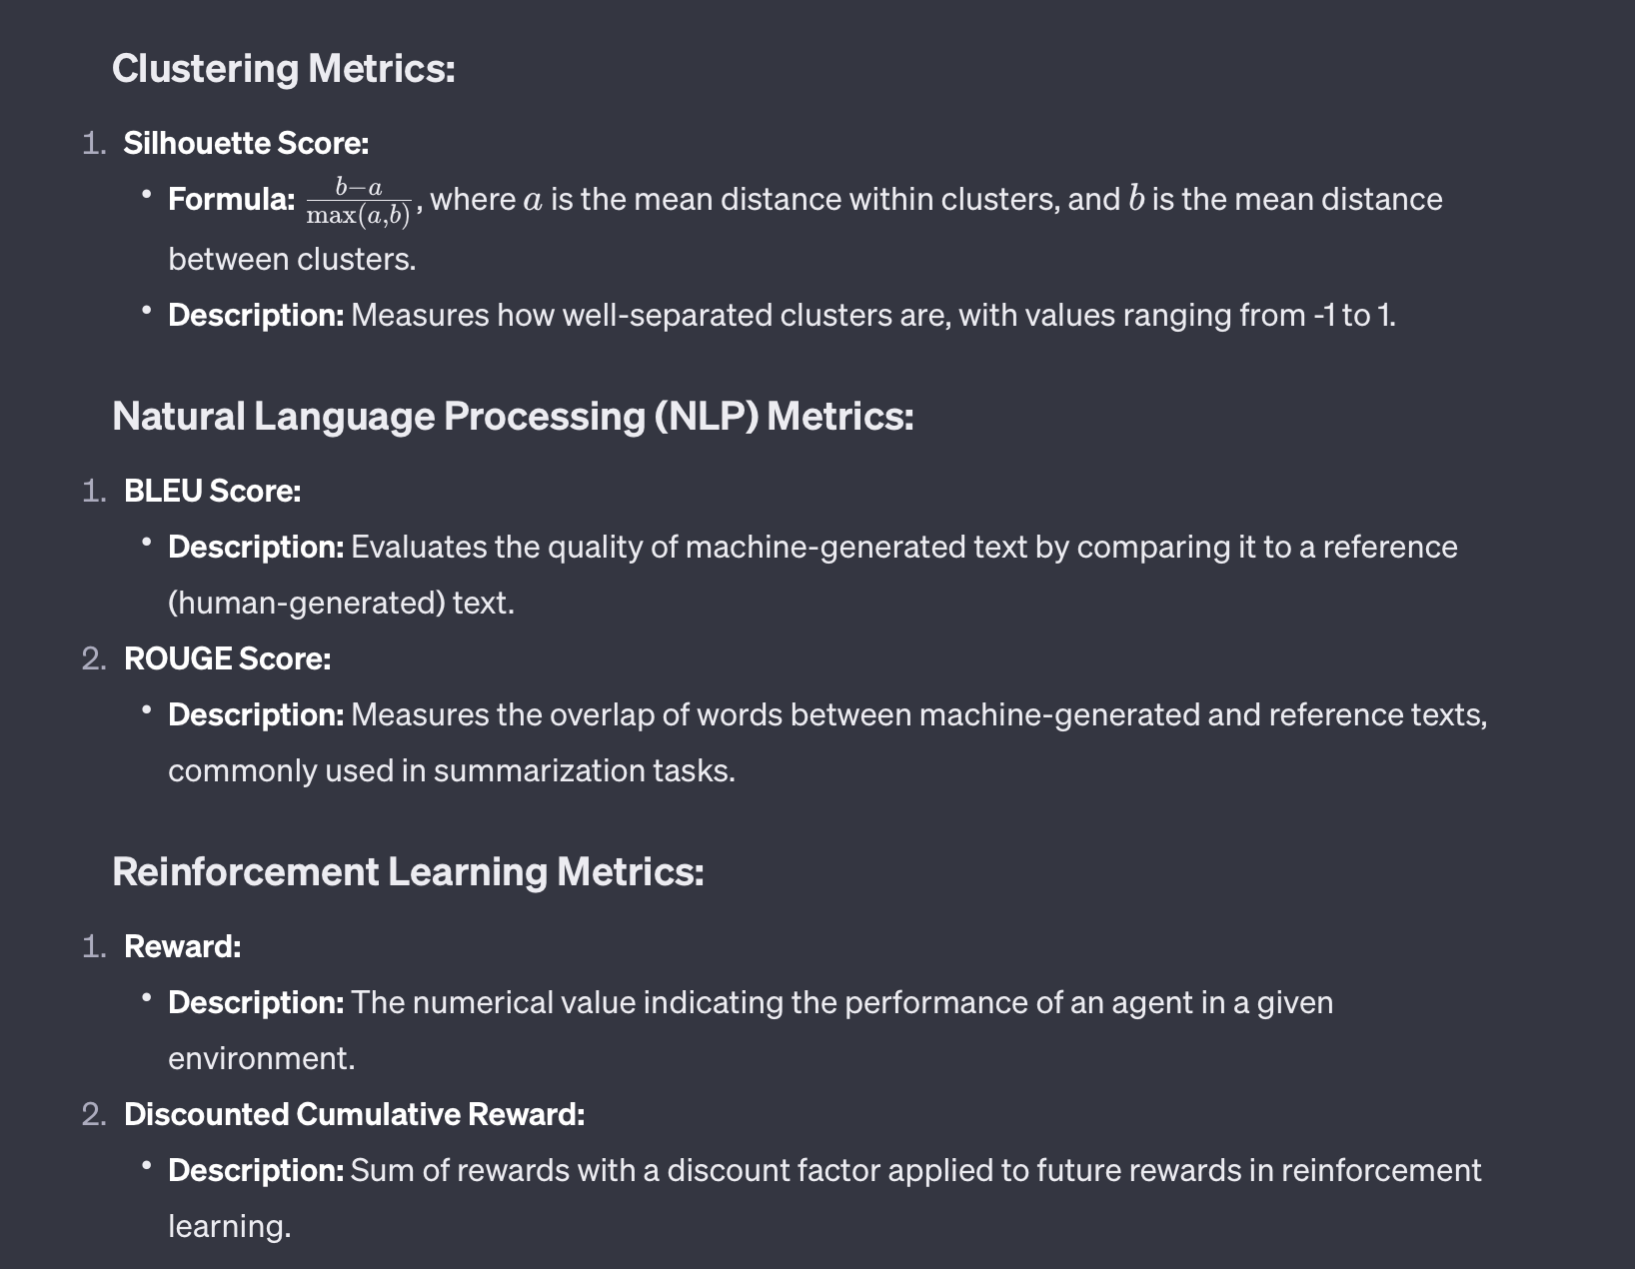
Key Metrics – Clustering and NLP

Slide 48
Model Evaluation
1. Train-Test Split:
Description: Divide the dataset into two subsets: a training set used for model training and a test set used for evaluation.
Purpose: Mimics the real-world scenario of a model encountering new, unseen data.
2. Cross-Validation:
Description: Split the dataset into multiple folds, train the model on different combinations of training and validation sets, and average the performance metrics.
Purpose: Provides a more robust estimate of model performance, especially when the dataset is limited.
3. Metrics for Classification Models:
4. Metrics for Regression Models:
5. Overfitting and Underfitting:
Description: Overfitting occurs when a model performs well on the training data but poorly on new data. Underfitting occurs when a model is too simple to capture the underlying patterns.
Actions: Adjust model complexity (e.g., increase or decrease the number of parameters). Use regularization techniques.
6. Learning Curves:
Description: Plot the model's performance on the training and validation sets as a function of training set size.
Purpose: Assess whether the model would benefit from more data and identify overfitting or underfitting.
7. Receiver Operating Characteristic (ROC) Curve:
Description: Visualizes the trade-off between true positive rate (sensitivity) and false positive rate at various classification thresholds.
Purpose: Especially useful for binary classification problems.
8. Area Under the Curve (AUC):
Description: Quantifies the overall performance of a classification model based on the ROC curve.
Purpose: AUC values closer to 1 indicate better model performance.
9. Confidence Intervals:
Description: Calculate confidence intervals around performance metrics to quantify the uncertainty in the model's evaluation.
Purpose: Provides a range of values within which the true performance metric is likely to fall.

Slide 49
Model Evaluation
10. Bias and Fairness Evaluation:
Description: Assess the model for biases and evaluate its fairness across different demographic groups.
Purpose: Ensure that the model does not exhibit discriminatory behavior.
11. Interpretability and Explainability:
Description: Use techniques like SHAP values, LIME, or feature importance to understand how the model makes predictions.
Purpose: Enhances trust in the model and provides insights into its decision-making process.
12. Deployment Considerations:
Description: Evaluate the model's performance in a real-world setting after deployment.
Purpose: Monitor for performance degradation, adapt to changing data distributions, and ensure ongoing reliability.

Slide 50
Interpreting complex datasets in AI
Feature Importance Analysis:
Techniques:
Permutation Importance: Measures the change in model performance when the values of a feature are randomly shuffled.
Tree-based Methods: Decision trees and ensemble methods (e.g., Random Forests) provide feature importance scores.
Cluster Profiling:
Description: Analyzes clusters in unsupervised learning, providing insights into the characteristics of different groups of data points.
Techniques: Descriptive statistics and visualization techniques can be used to profile clusters.
A/B Testing and Causal Inference:
Description: For understanding the impact of changes or interventions, such as model updates or new features.
Techniques: Conducting controlled experiments to measure the causal effect of a change.
Dimensionality Reduction:
Techniques: Techniques like Principal Component Analysis (PCA) help reduce the dimensionality of the data while preserving essential information.
Cross-Validation Analysis:
Techniques: Examining model performance across different folds in cross-validation can reveal how stable the model is and identify potential issues.
Model Evaluation Metrics:
Techniques: Utilizing metrics such as precision, recall, F1 score, ROC curves, and confusion matrices for classification tasks, or mean absolute error, mean squared error, and R-squared for regression tasks.
Ethical AI Audits:
Techniques: Assessing models for fairness, bias, and ethical considerations. Metrics like disparate impact and demographic parity are used to evaluate fairness.

Slide 51
Optimizer and Loss Function
Loss Function:
Definition:
A loss function, also known as a cost function or objective function, quantifies the difference between the predicted values of a model and the actual target values. It represents the error or cost associated with the model's predictions.
Purpose:
The goal during training is to minimize the loss function, meaning the model is making predictions that are as close as possible to the true values. Different tasks (classification, regression, etc.) and types of models may require different loss functions.
Examples:
For regression tasks, Mean Squared Error (MSE) is a common loss function. For classification tasks, cross-entropy loss (binary or categorical) is often used.
Mathematical Representation:
If yy is the true label and y^y^​ is the predicted label, the basic form of a loss function can be represented as L(y,y^)L(y,y^​).
Optimizer:
Definition:
An optimizer is an algorithm or method used to minimize the loss function by adjusting the model's parameters (weights and biases). The optimizer iteratively updates the model parameters based on the gradients of the loss function with respect to these parameters.
Purpose:
The optimizer is responsible for navigating the model parameter space in the direction that reduces the loss, effectively guiding the model towards a configuration where predictions align better with the true values.
Examples:
Common optimizers include Stochastic Gradient Descent (SGD), Adam, RMSprop, and Adagrad. These optimizers use different strategies to adjust model parameters and control the learning rate during training.
Parameters:
Optimizers often have hyperparameters, such as the learning rate, that need to be carefully tuned. The learning rate determines the step size during each update, influencing the convergence and stability of the training process.

Slide 52
ML Ops
Operationalize ML projects requires the use of automated pipelines and development-operations (DevOps) methodologies
Two major operations happening—
the training of a model and
the deployment of a model.
Training pipeline: This includes loading datasets (possibly even including an ETL pipeline), transformation, model training, and registering final models. This pipeline could be triggered by changes in the dataset or possible detected data drift in a deployed model.
Deployment pipeline: This includes loading of models from the registry, creating and deploying Docker images, creating and deploying operational scripts, and the final deployment of the model to the target. This pipeline could be triggered by new versions of an ML model.

Slide 53
Life cycle for ML projects
Creating or retraining a model:
Here, we use training pipelines to create or retrain our model while version-controlling the pipelines and the code.
Deploying the model and creating scoring files and dependencies:
Here, we use a deployment pipeline to deploy a specific model version while version-controlling the pipeline and the code.
Creating an audit trail:
Through CI/CD pipelines and version control, we create an audit trail for all assets ensuring integrity and compliance.
Monitoring model in production:
We monitor the performance and possible data drift, which might automatically trigger retraining of the model.

Slide 54
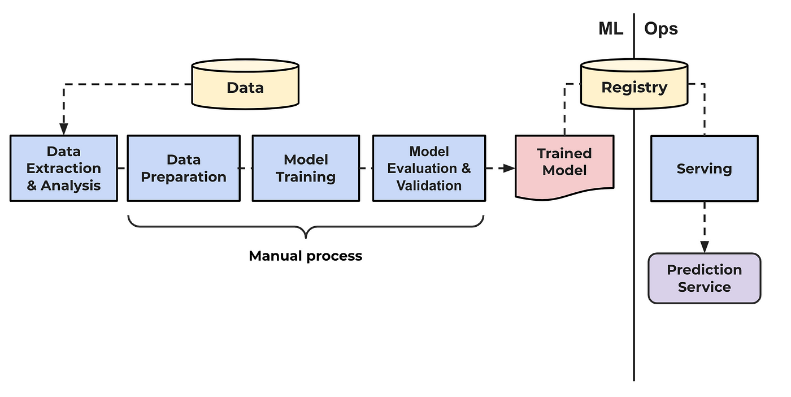
ML Ops Pipeline

Slide 55
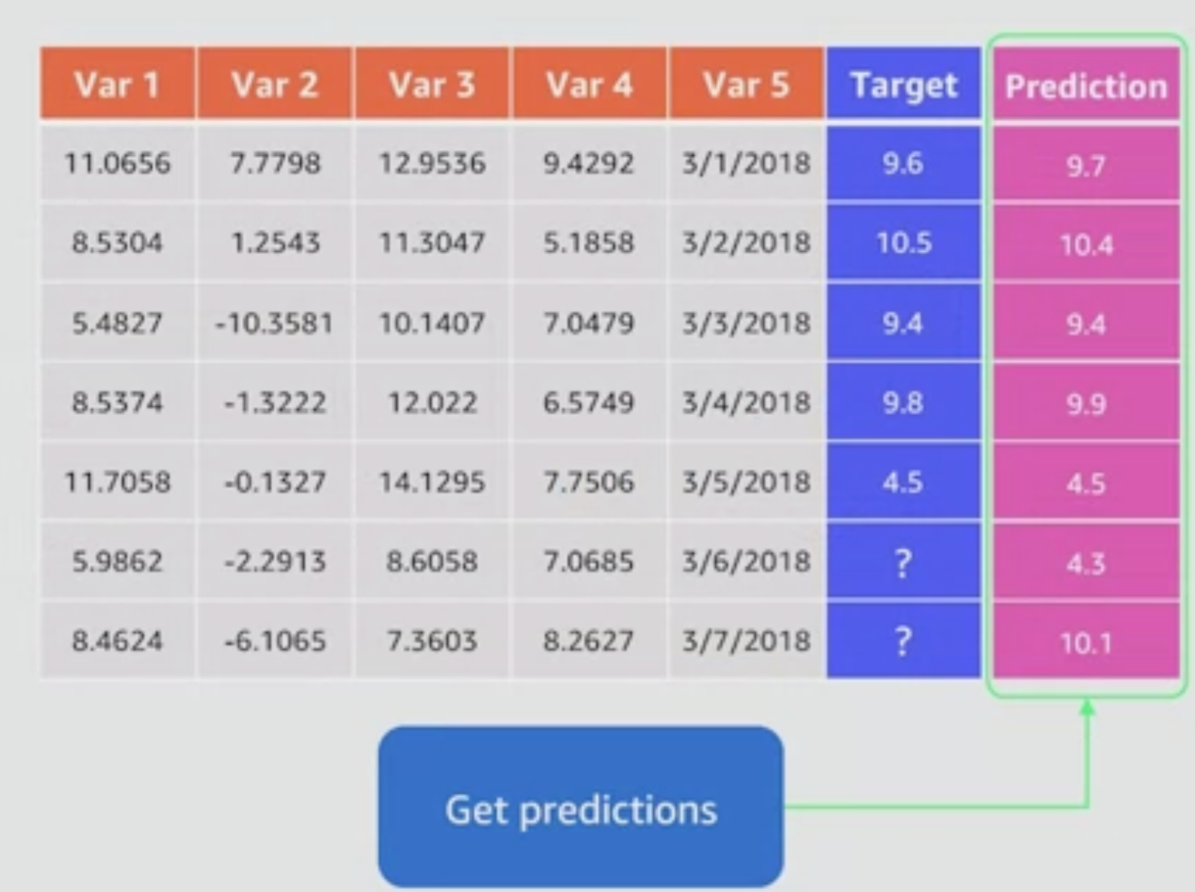
Example table with target and Prediction

Slide 56
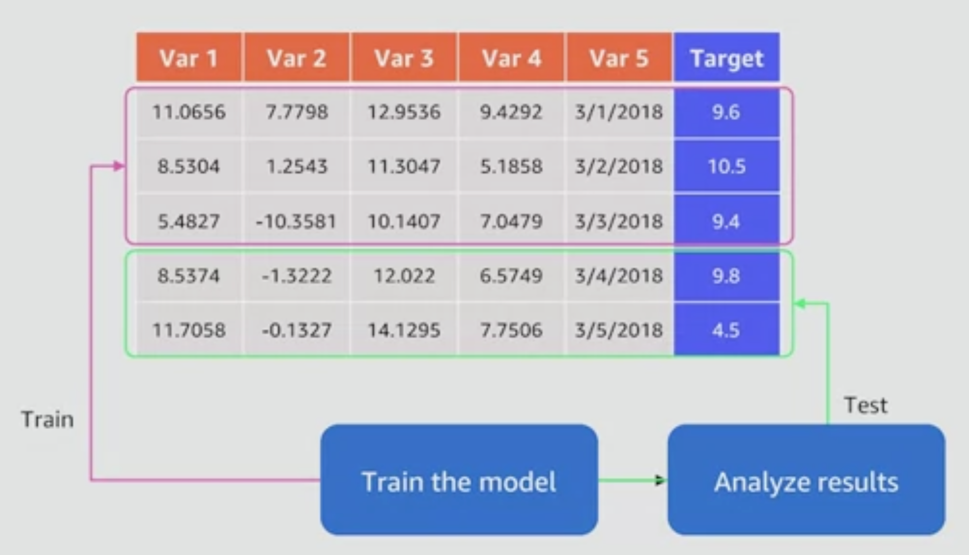
Train Test Split of data

Slide 57
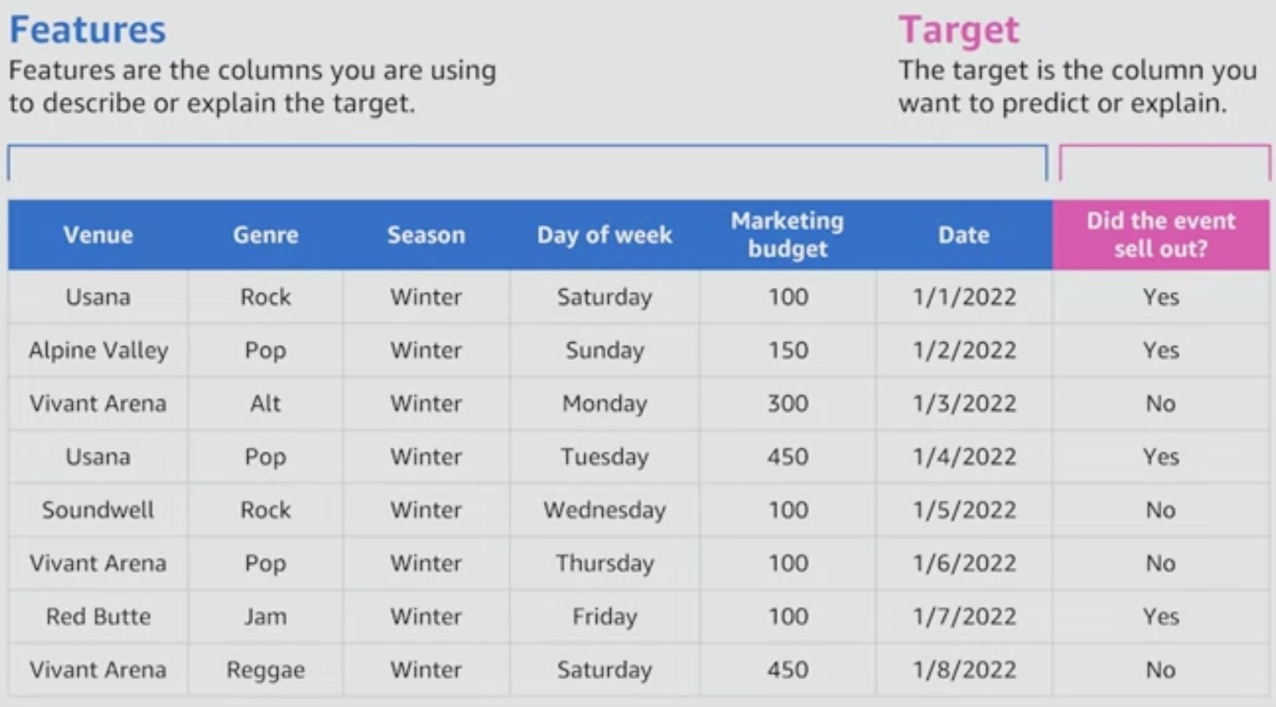
Features and Targets

Slide 58
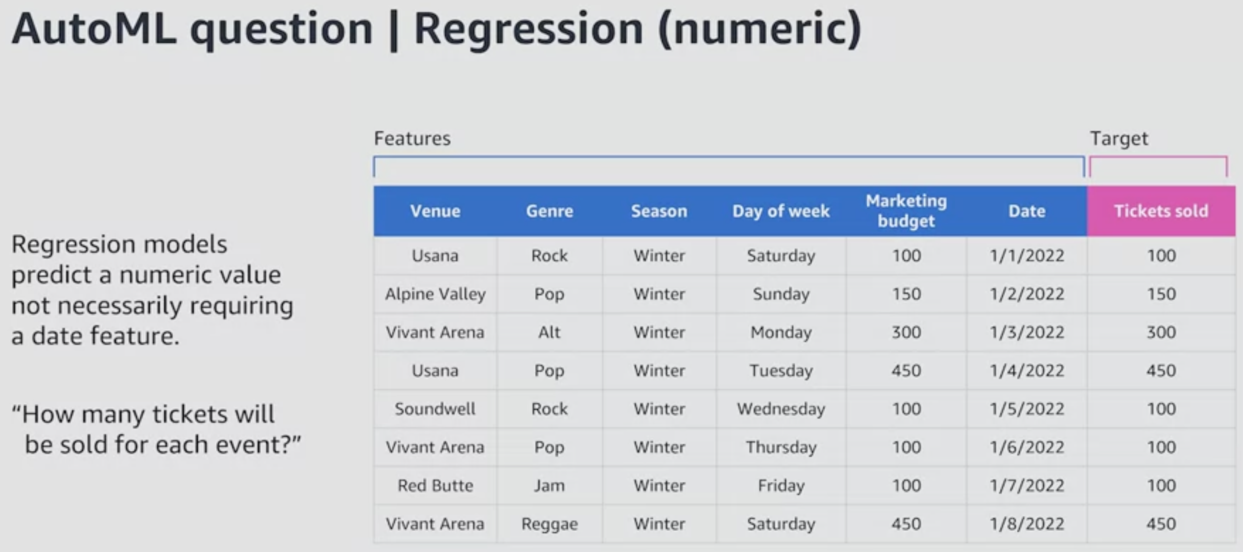
Regression Models

Slide 59
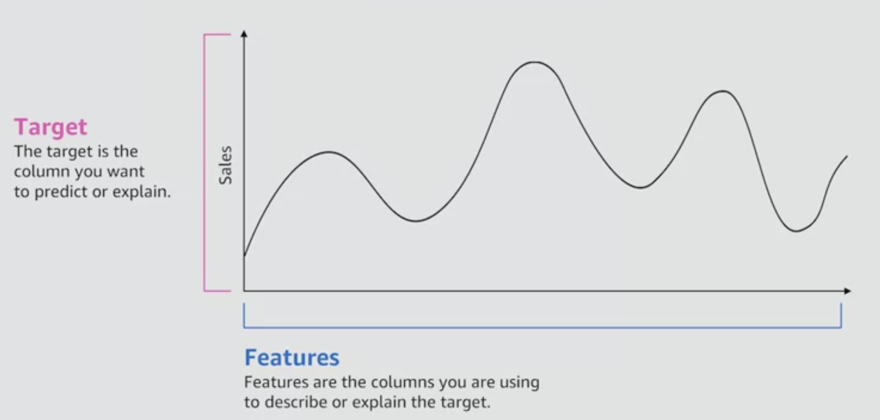
Features and Targets as Graph

Slide 60
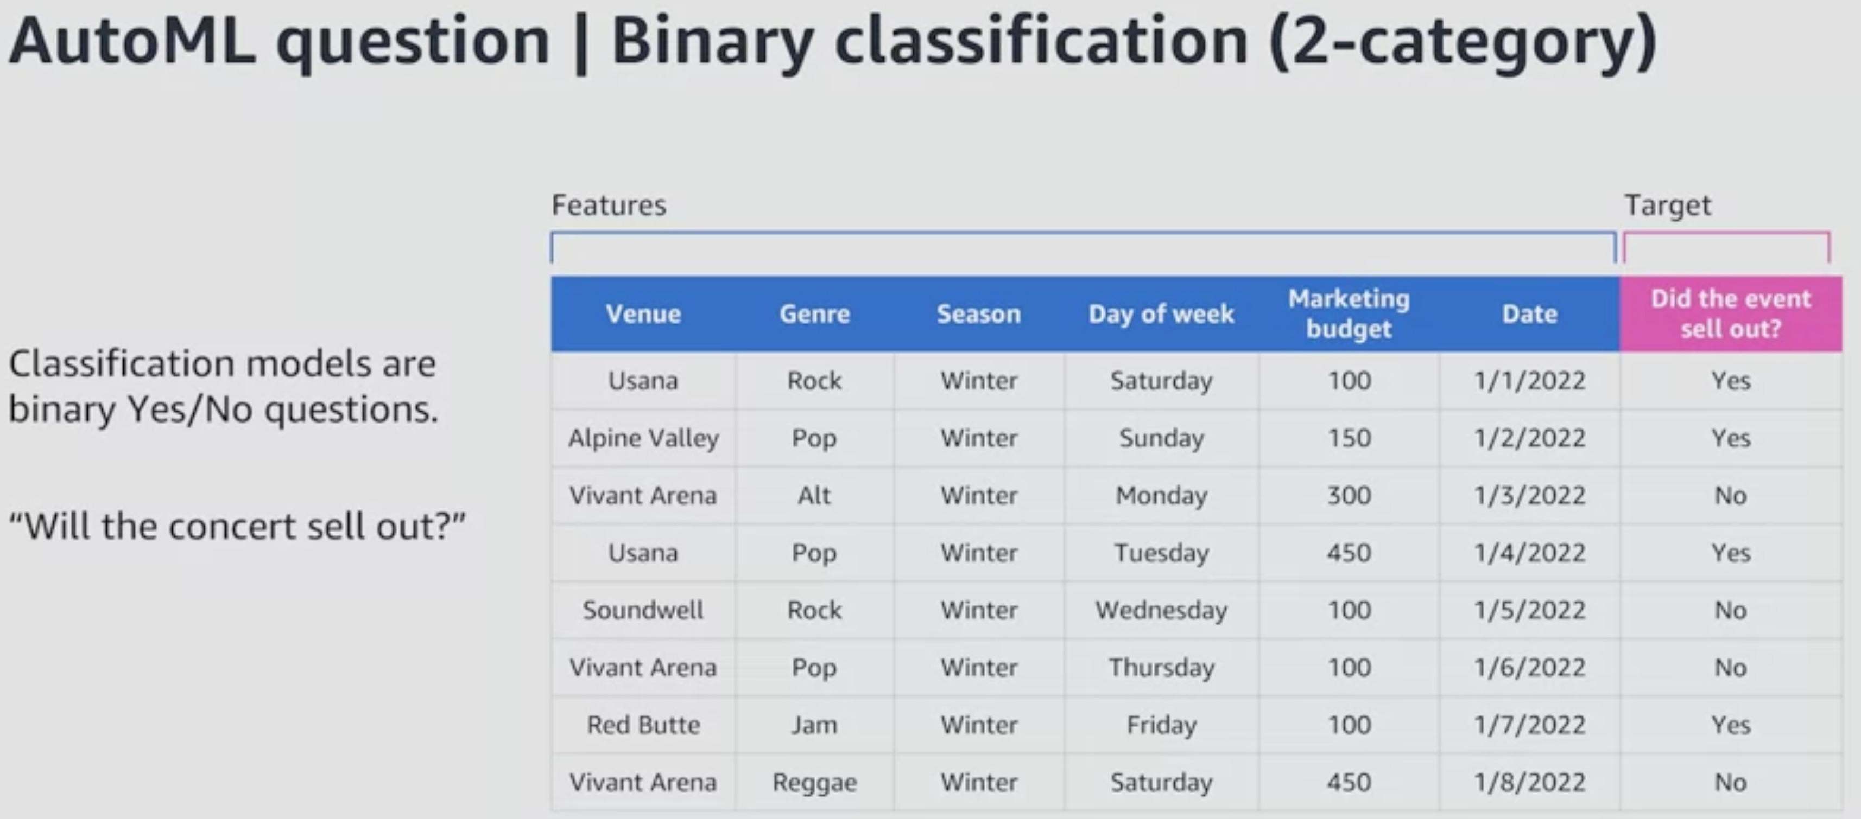
Binary Classification

Slide 61
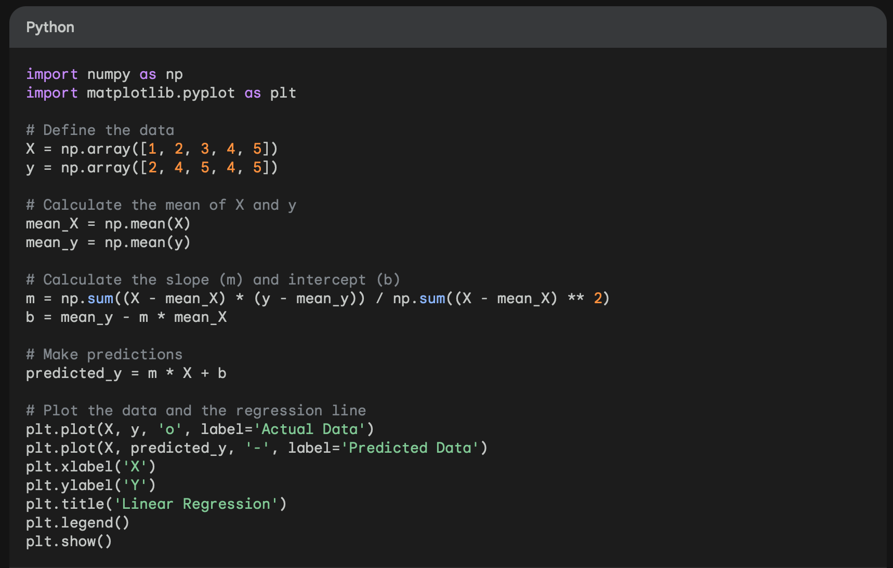
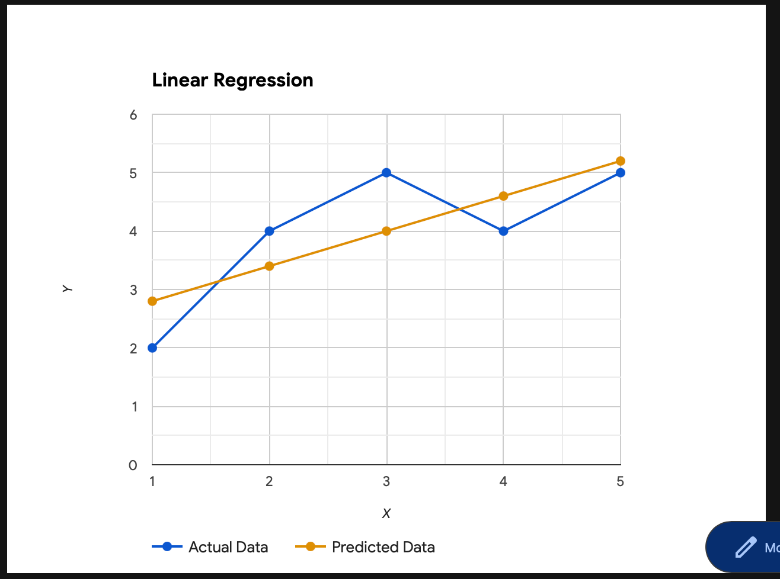
Linear Regression Example

Slide 62
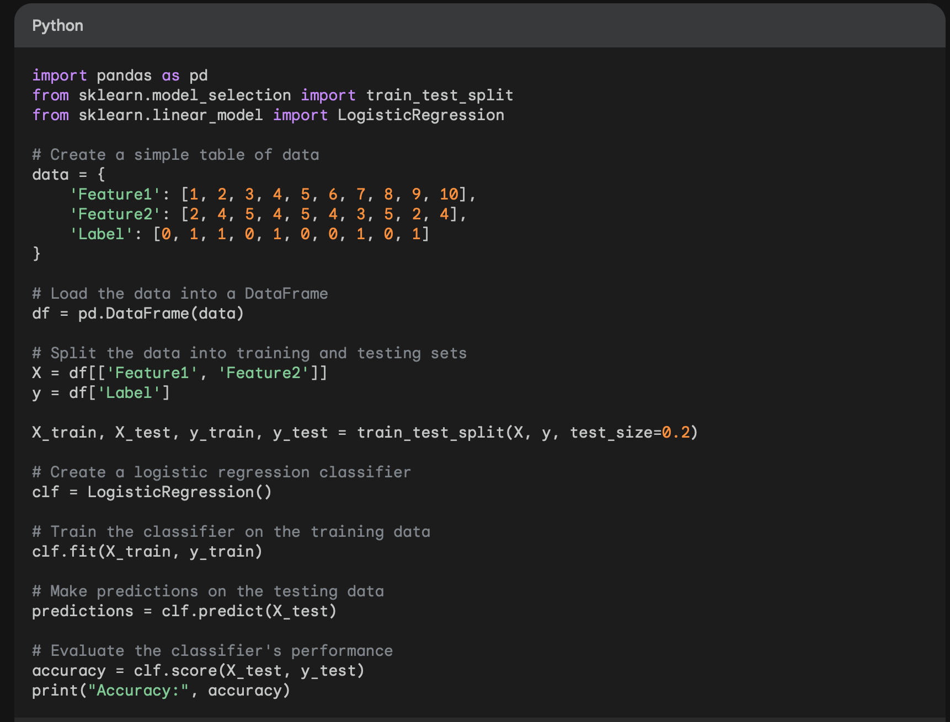
Logistic Regression Example
This code will create a simple table of data with two features (Feature1 and Feature2) and one label (Label). The label is either 0 or 1. The code will then split the data into training and testing sets, create a logistic regression classifier, train the classifier on the training data, make predictions on the testing data, and evaluate the classifier's performance.
The output of the code will be something like this: Accuracy: 0.9
This means that the classifier was able to correctly classify 90% of the data points in the testing set.

Slide 63
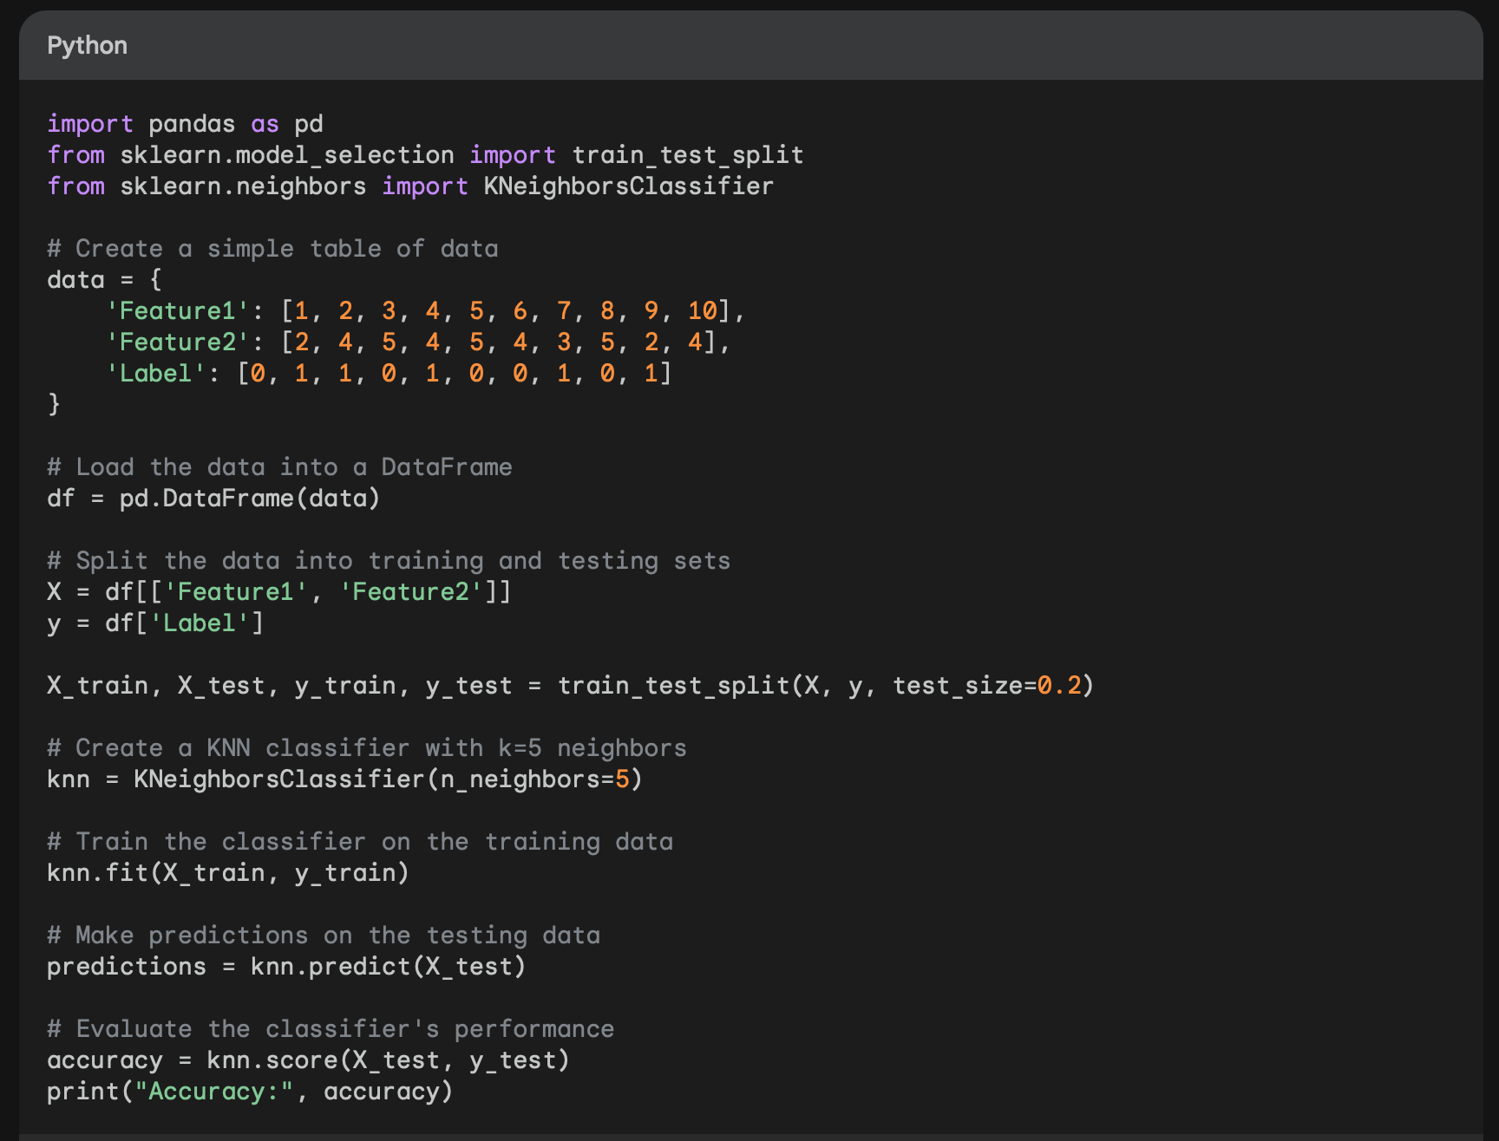
K- Nearest Neighbour Example
This code will create a simple table of data with two features (Feature1 and Feature2) and one label (Label). The label is either 0 or 1. The code will then split the data into training and testing sets, create a KNN classifier with k=5 neighbors, train the classifier on the training data, make predictions on the testing data, and evaluate the classifier's performance.
The output of the code will be something like this: Accuracy: 0.9
This means that the classifier was able to correctly classify 90% of the data points in the testing set.

Slide 64
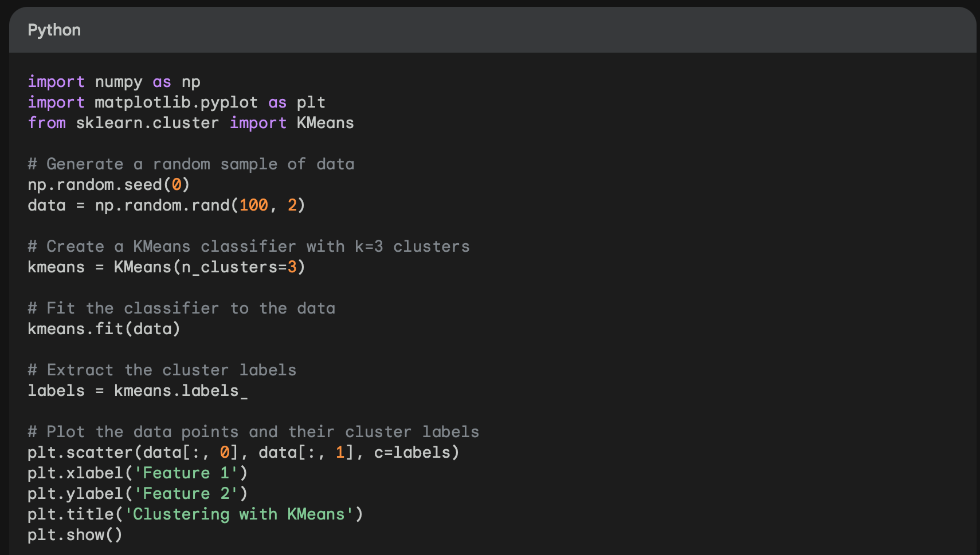
K-Means Clustering Example
Here is a breakdown of the code:
Import Libraries: Import the necessary libraries for data generation, clustering, and plotting.
Generate Data: Generate a random sample of 100 data points with two features using np.random.rand(100, 2).
Create KMeans Model: Initialize a KMeans model with the desired number of clusters (in this case, 3) using kmeans = KMeans(n_clusters=3).
Fit KMeans Model: Fit the KMeans model to the generated data using kmeans.fit(data).
Extract Cluster Labels: Extract the cluster labels assigned to each data point using labels = kmeans.labels_.
Create Scatter Plot: Create a scatter plot using plt.scatter(data[:, 0], data[:, 1], c=labels).
Add Labels and Title: Add labels for the axes and a title for the plot using plt.xlabel('Feature 1'), plt.ylabel('Feature 2'), and plt.title('Clustering with KMeans'), respectively.
Display Plot: Display the generated scatter plot using plt.show().

Slide 65
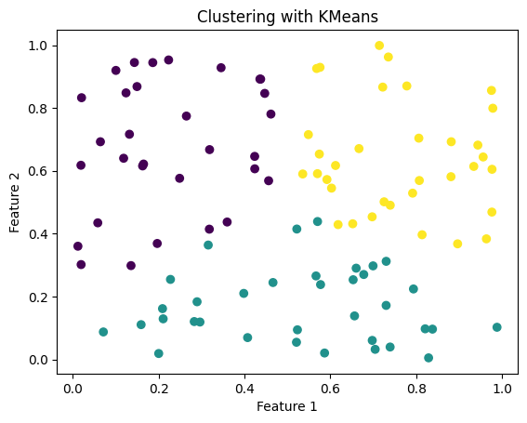
K-Means Clustering Example
This code will generate a random sample of 100 data points with two features. It will then create a KMeans classifier with k=3 clusters and fit the classifier to the data. Finally, it will extract the cluster labels and plot the data points and their cluster labels.
The output of the code will be a scatter plot of the data points, with each data point colored according to its cluster label.

Slide 66
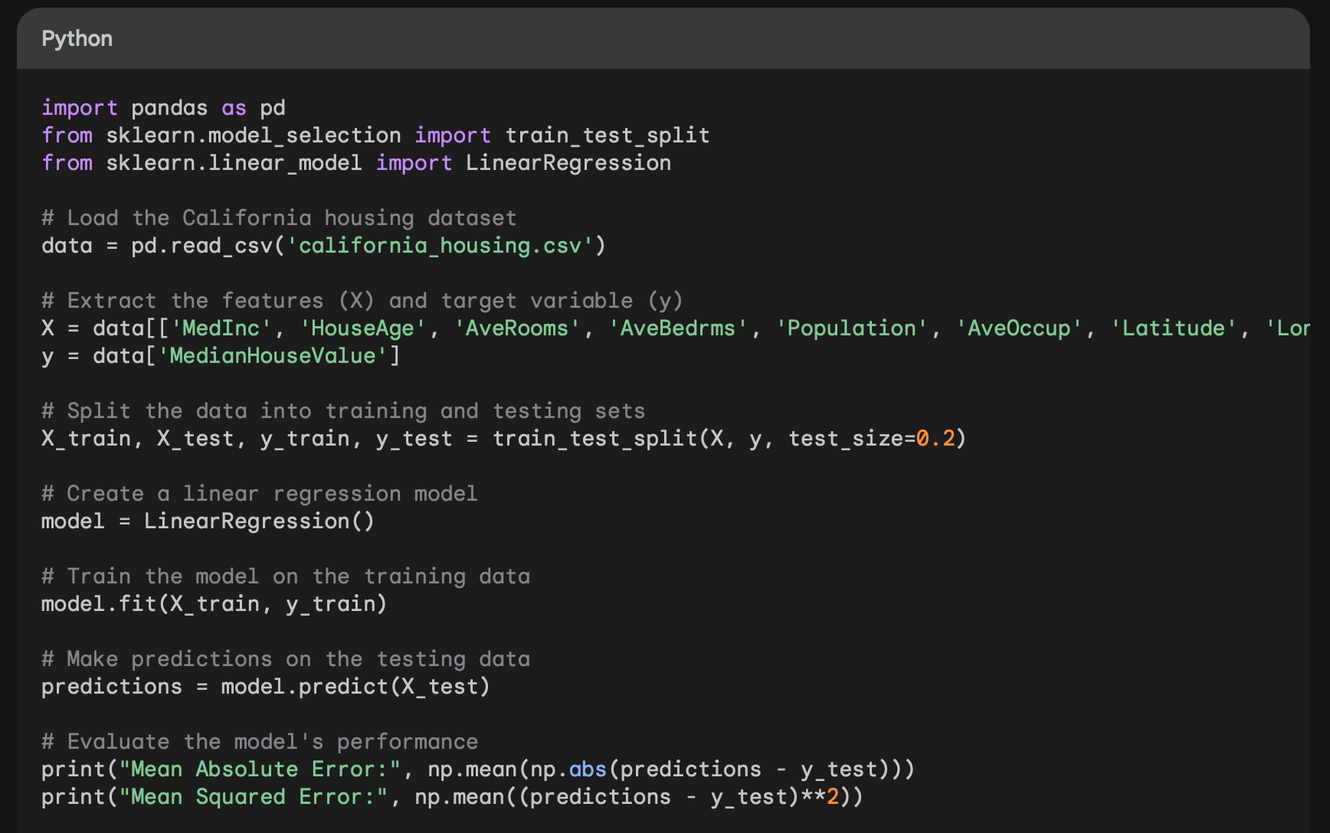
Linear Regression for California housing
Here is a breakdown of the code:
Import Libraries:
pandas is used to load the California housing dataset from a CSV file.
sklearn.model_selection is used to split the data into training and testing sets.
sklearn.linear_model is used to create and train the linear regression model.
Load Data: pd.read_csv() loads the California housing dataset from a CSV file into a Pandas DataFrame.
Extract Features and Target Variable:
X contains the features (all columns except the last).
y contains the target variable (last column).
Split Data into Training and Testing Sets: train_test_split() splits the data into training and testing sets with a 20% testing set.
Create Linear Regression Model: LinearRegression() creates a linear regression model object.
Train the Model: fit() trains the model on the training data.
Make Predictions: predict() generates predictions for the testing data.
Evaluate Model Performance:
Mean Absolute Error (MAE) and Mean Squared Error (MSE) are used to assess the model's accuracy.

Slide 67
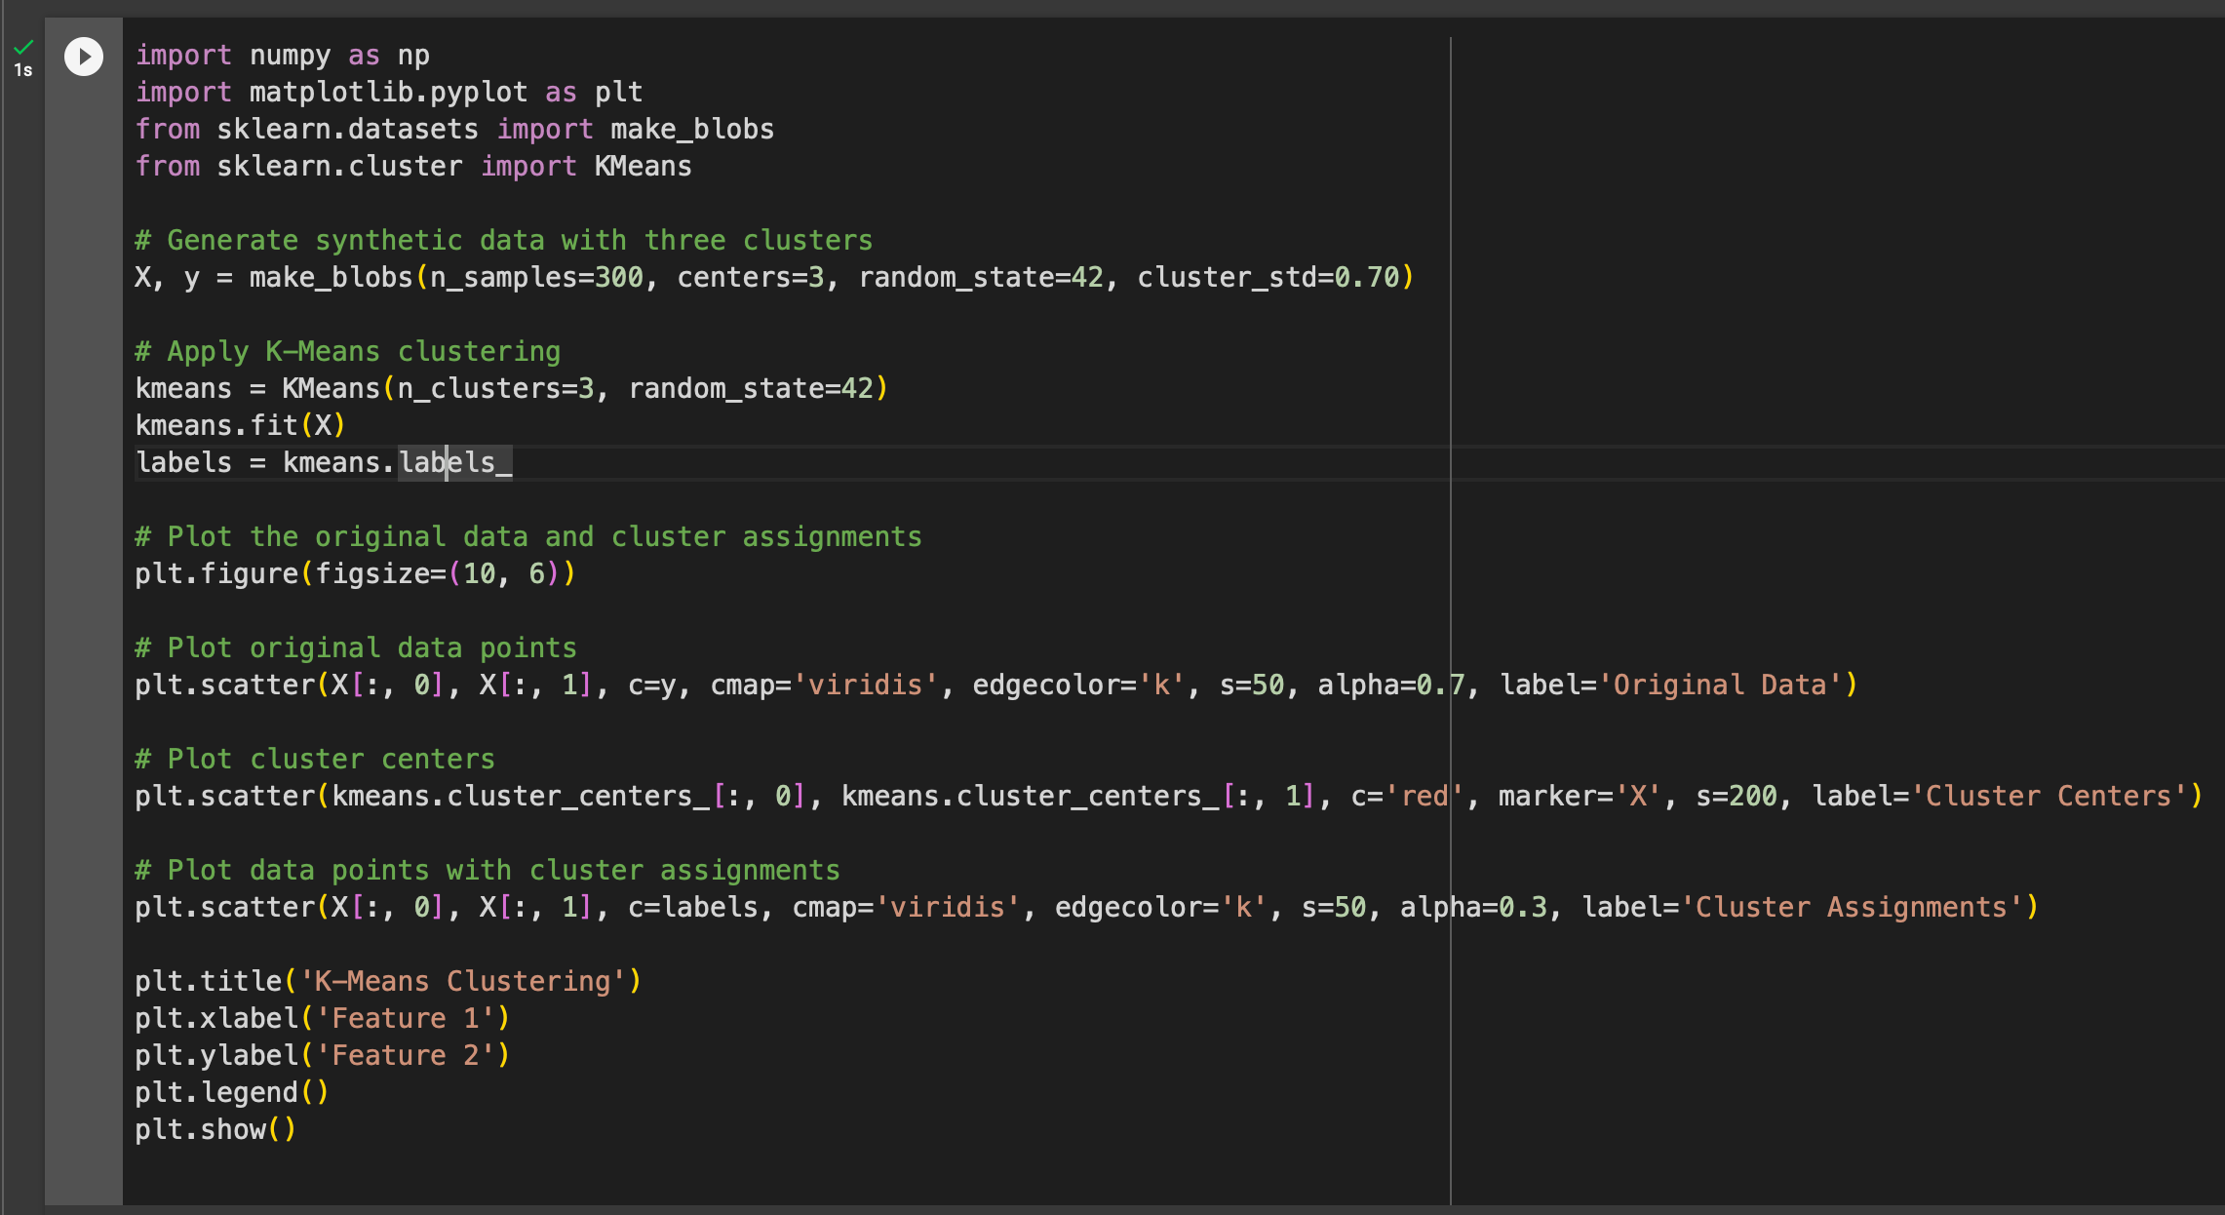
Unsupervised Learning K-Means Clustering Algorithm to group data into clusters
In this example:
We generate synthetic data with three clusters using the make_blobs function.
We apply the K-Means clustering algorithm to group the data points into three clusters.
We plot the original data points, cluster centers (marked with red 'X'), and the data points with their assigned clusters.
This code will produce a chart showing the original data points, the cluster centers, and the data points assigned to their respective clusters. Each color represents a different cluster, and the red 'X' markers indicate the cluster centers.

Slide 68
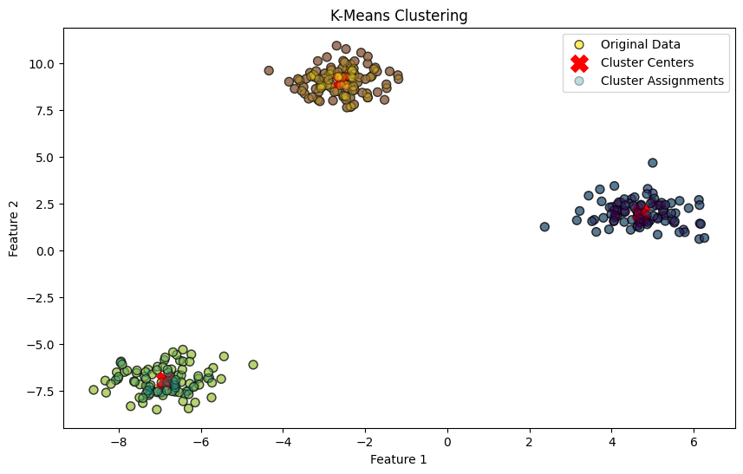
Unsupervised Learning K-Means Clustering Algorithm

Slide 69
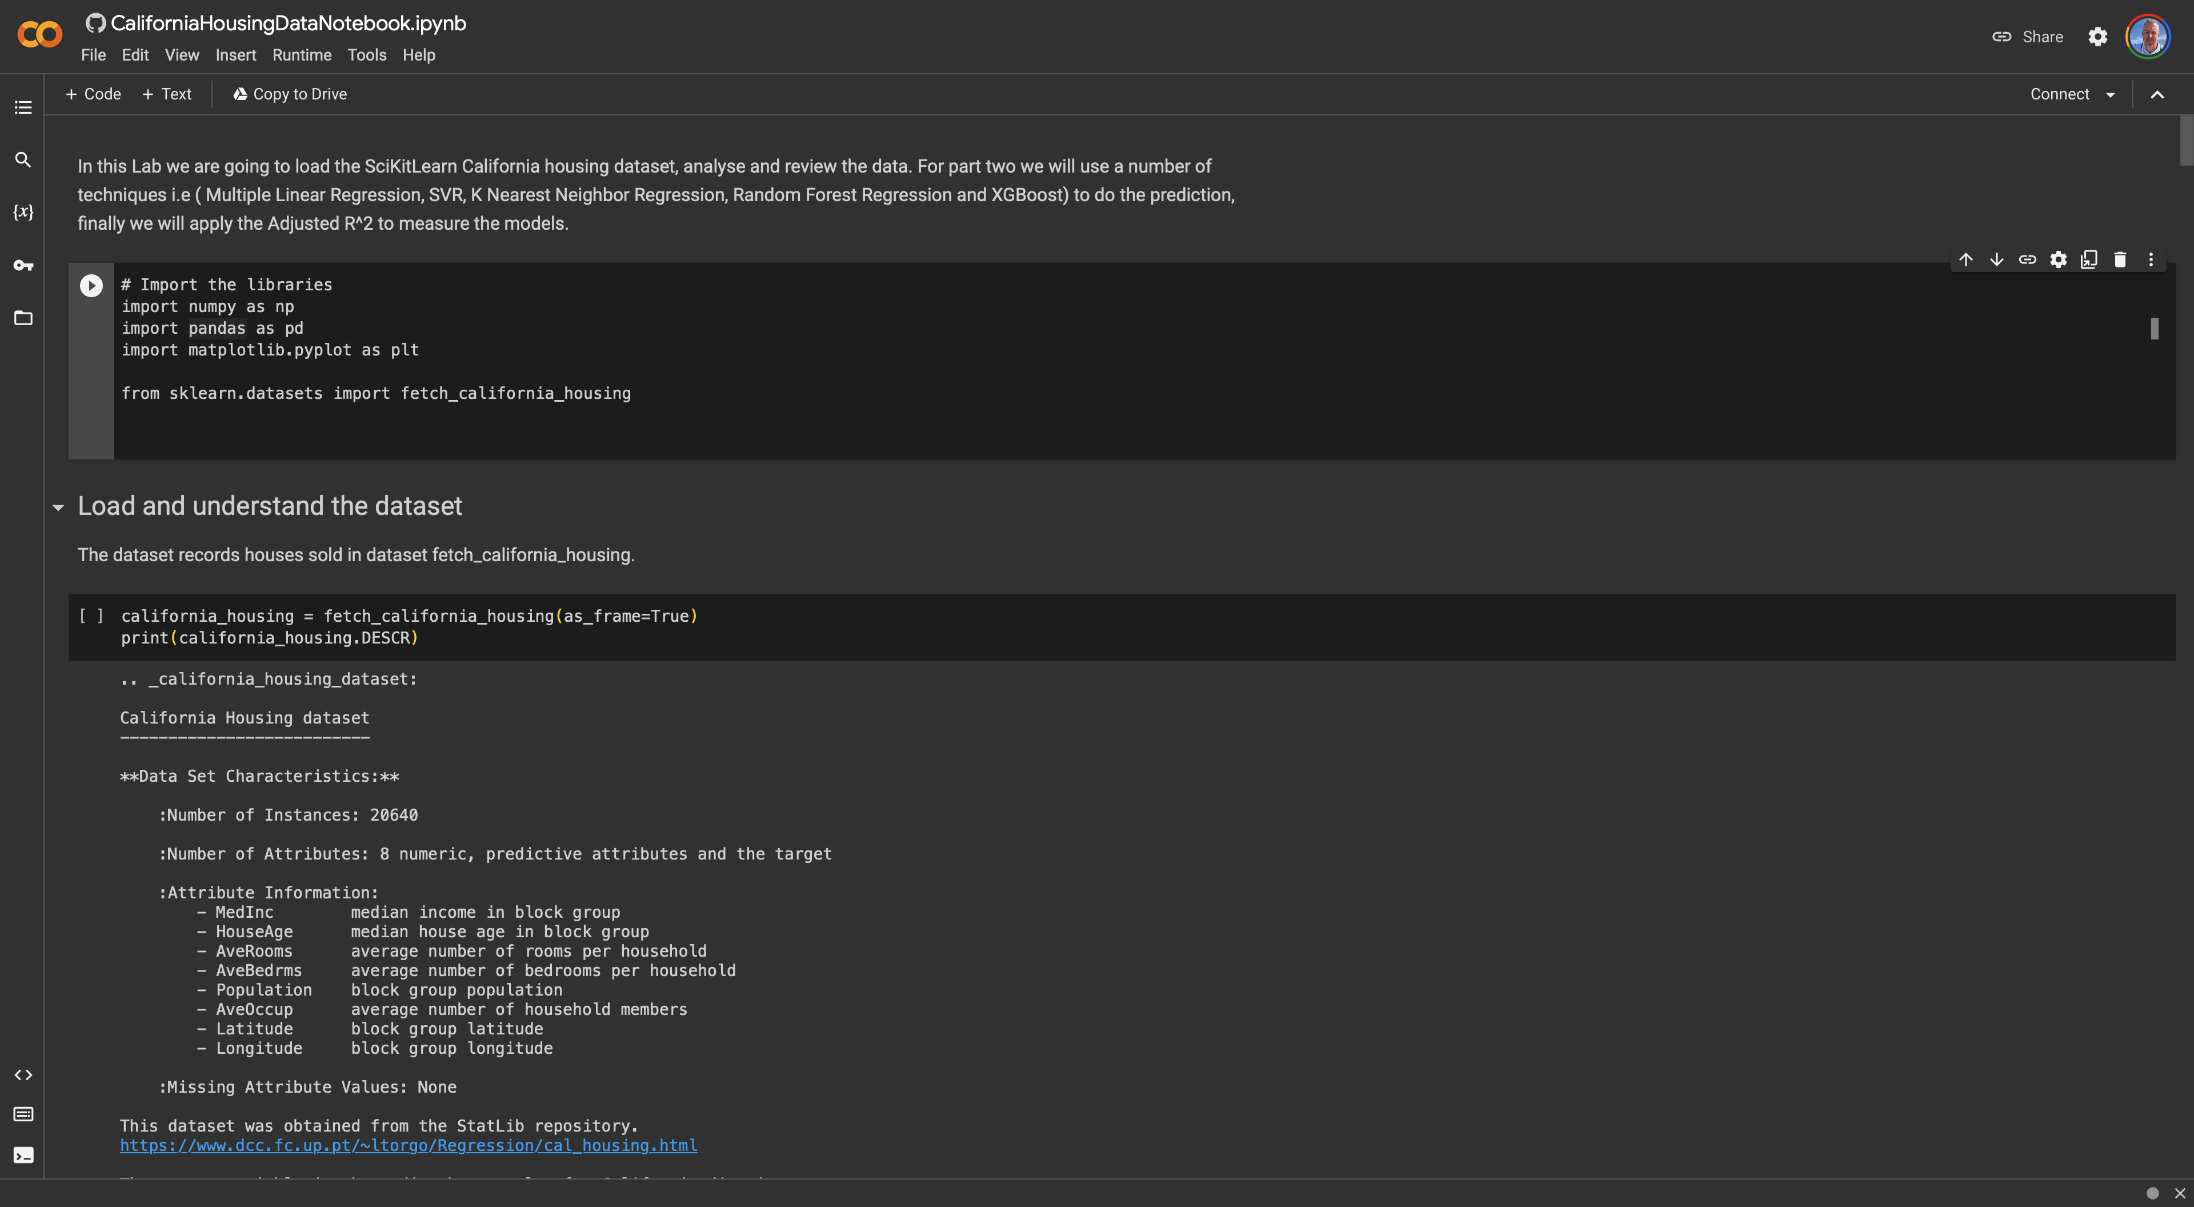
Desktop Apps
Python - for programming
Git – for source code version control
Jupyter Notebooks – Interactive Programming & Data Analysis
VSCode – Desktop IDE for coding
PyCharm – Another good IDE for ML tasks

Slide 70
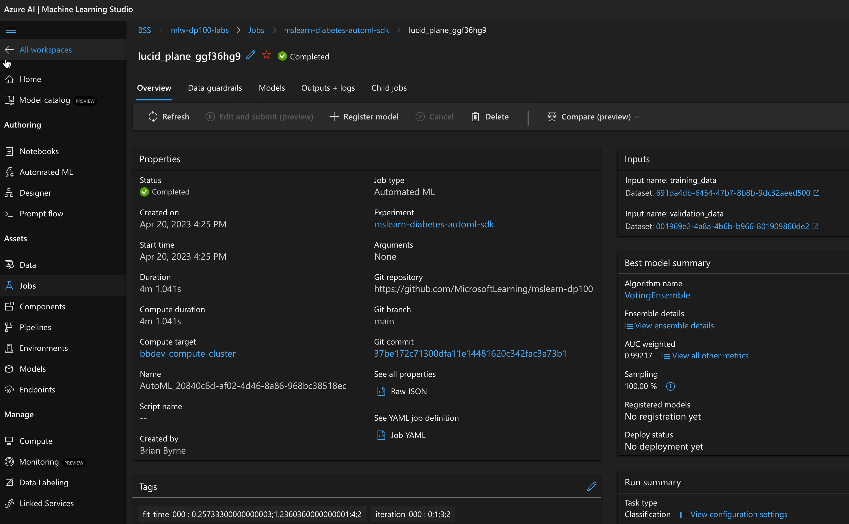
ML Cloud Apps
Azure ML Studio
AWS AutoML
Google COLAB
IBM Watson Studio

Slide 71
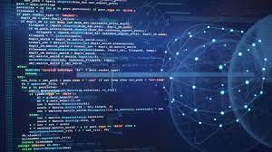
Python ML Software Frameworks
SciKit-Learn – ML library featuring may common algorithms
MatplotLib – Python framework for data visualation
Numpy – Numeric analysis and manipulation
Seaborne – Data visualization and data analyzis
Pandas – Data Science and Machine Learning package

Slide 72
AI Popular software frameworks
TensorFlow:
Description: Developed by Google Brain, TensorFlow is an open-source machine learning framework widely used for deep learning applications. It provides a comprehensive ecosystem for building and deploying machine learning models.
PyTorch:
Description: Developed by Facebook's AI Research lab (FAIR), PyTorch is another popular open-source deep learning framework. It is known for its dynamic computational graph, making it more intuitive for researchers and developers.
Keras:
Description: Originally developed as an independent high-level neural networks API, Keras has been integrated with TensorFlow as its official high-level API. It provides a user-friendly interface for building and experimenting with neural networks.
Scikit-learn:
Description: Scikit-learn is a machine learning library for Python that focuses on classical ML algorithms. It provides simple and efficient tools for data analysis and modeling, including classification, regression, clustering, and more.
MXNet:
Description: MXNet is an open-source deep learning framework developed by the Apache Software Foundation. It supports both symbolic and imperative programming, making it flexible for a range of deep learning tasks.
Caffe:
Description: Caffe is a deep learning framework developed by the Berkeley Vision and Learning Center (BVLC). It is widely used for image classification and convolutional neural networks (CNNs).
Microsoft Cognitive Toolkit (CNTK):
Description: Also known as CNTK, the Microsoft Cognitive Toolkit is an open-source deep learning framework developed by Microsoft. It is designed for efficient training of deep learning models.

Slide 73
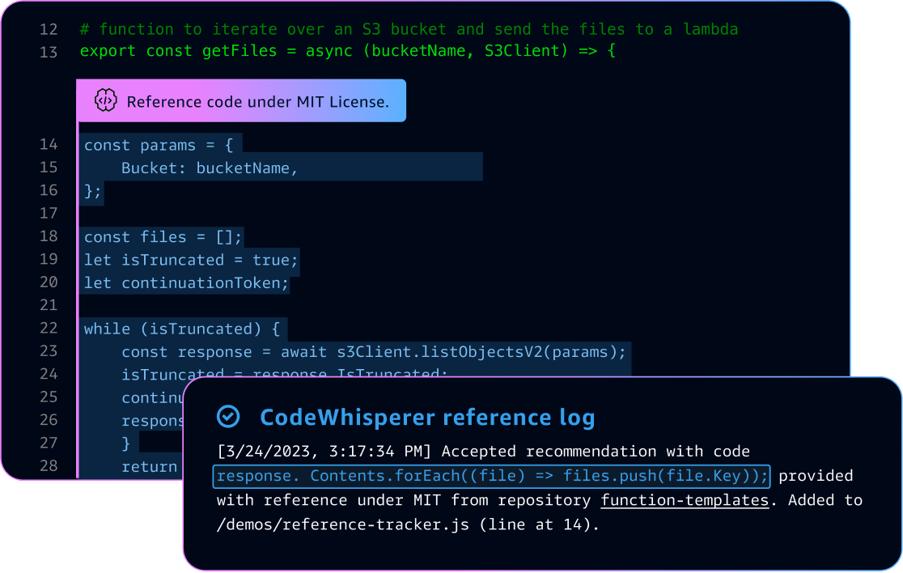
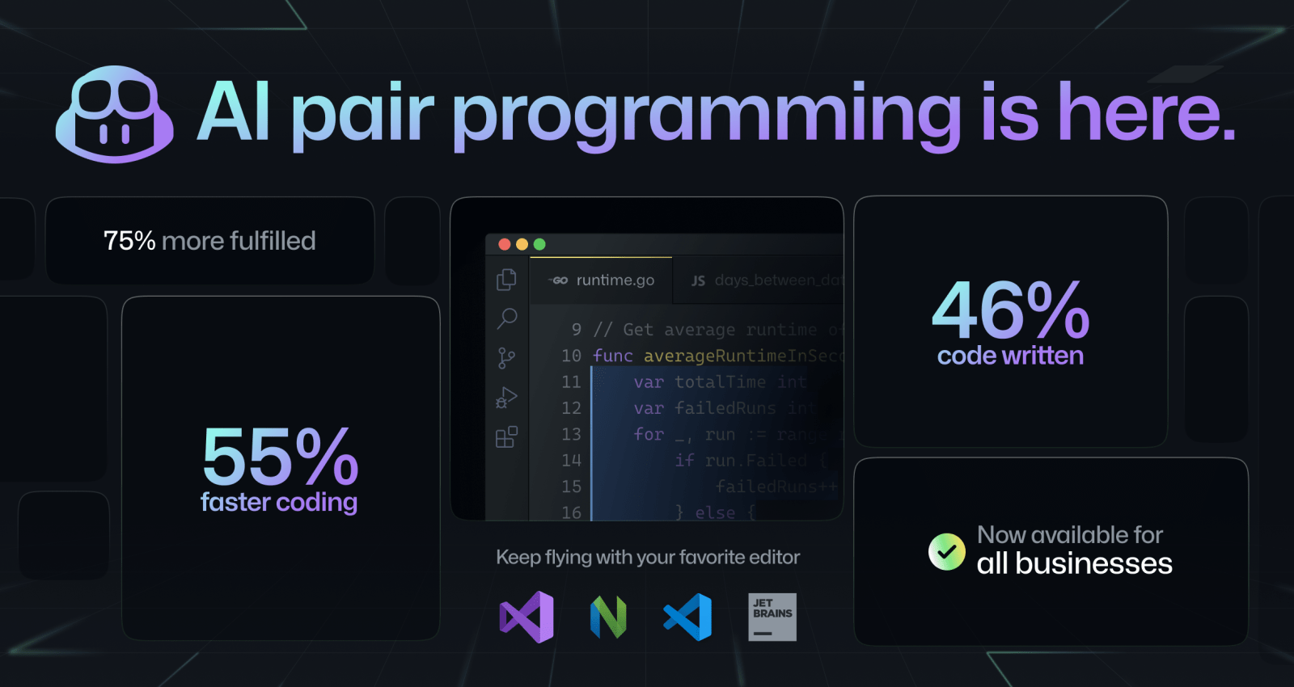
AI in Software
Google Bard
AWS Code Whisperer
GitHub Copilot …
Chat GPT

Slide 74
AI in Business Examples
Healthcare: Predictive Analytics for Patient Care
Example: Predictive analytics models are being used to anticipate patient outcomes and identify individuals at risk of specific medical conditions. Machine learning algorithms analyze patient data, including electronic health records and diagnostic images, to predict the likelihood of diseases such as diabetes, sepsis, or heart conditions. This enables proactive and personalized healthcare interventions, leading to better patient outcomes.
Finance: Fraud Detection and Risk Management
Example: AI is extensively used in the financial industry for fraud detection and risk management. Machine learning algorithms analyze transaction patterns, user behavior, and historical data to identify unusual activities indicative of fraud. These systems can quickly flag suspicious transactions, helping financial institutions prevent fraudulent activities and enhance overall security.
Manufacturing: Predictive Maintenance
Example: Predictive maintenance systems leverage AI and machine learning to forecast when equipment and machinery in manufacturing plants are likely to fail. By analyzing data from sensors and historical maintenance records, these systems can predict when maintenance is needed, minimizing downtime, reducing costs, and preventing unexpected breakdowns. This approach improves overall equipment efficiency and extends the lifespan of machinery.
Retail: Personalized Customer Experiences
Example: AI is used in retail to create personalized customer experiences. Recommendation engines, powered by machine learning algorithms, analyze customer behavior, preferences, and historical purchase data to suggest products tailored to individual preferences. This not only enhances customer satisfaction but also contributes to increased sales and customer loyalty. Virtual assistants and chatbots are also employed for customer support and engagement.
Transportation: Autonomous Vehicles
Example: The development of autonomous vehicles is a groundbreaking application of AI in the transportation industry. Machine learning algorithms process data from sensors, cameras, and radar systems to enable vehicles to navigate, perceive their surroundings, and make real-time decisions. Autonomous vehicles have the potential to revolutionize transportation, making it safer, more efficient, and accessible.

Slide 75
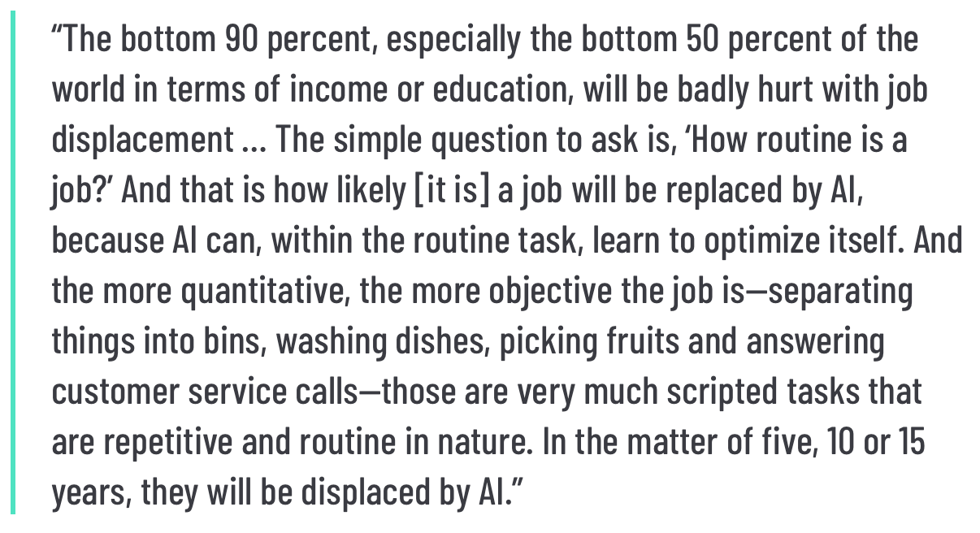
How AI will change work
Northwestern University, AI expert Kai-Fu Lee

Slide 76

Future of AI
Advancements in Deep Learning Architectures:
Continued research and development in deep learning will lead to more sophisticated neural network architectures, enabling AI models to handle increasingly complex tasks and learn hierarchical representations of data.
Explainable AI (XAI) and Ethical AI:
As AI systems become more prevalent, there will be a growing emphasis on developing models that are explainable and transparent. Explainable AI (XAI) techniques will be crucial for understanding and trusting AI decisions. Additionally, ethical considerations in AI, including fairness, accountability, and bias mitigation, will become more prominent.
AI for Edge Computing and IoT:
The integration of AI with edge computing devices and the Internet of Things (IoT) will become more widespread. This trend will enable AI models to process and analyze data locally, reducing latency and enhancing real-time decision-making capabilities in various applications, from smart homes to industrial settings.
AI in Healthcare for Personalized Medicine:
AI will play a significant role in the advancement of personalized medicine. Machine learning models will analyze vast amounts of genomic, clinical, and lifestyle data to tailor medical treatments and interventions to individual patients. This will lead to more effective and targeted healthcare solutions.
AI Collaboration and Human-AI Partnerships:
The future of AI will involve increased collaboration between humans and AI systems. Augmented intelligence, where AI assists and enhances human decision-making, will become more prevalent across industries. Human-AI partnerships will be crucial for addressing complex challenges and driving innovation.

Slide 77
References
History of AI
https://sitn.hms.harvard.edu/flash/2017/history-artificial-intelligence/
Handwritten digits article
https://thedatafrog.com/en/articles/handwritten-digit-recognition-scikit-learn/
Scikit Learn Recognizing hand written digits
https://scikit-learn.org/stable/auto_examples/classification/plot_digits_classification.html#sphx-glr-auto-examples-classification-plot-digits-classification-py
https://www.coursera.org/learn/no-code-ml-aws/lecture/
https://builtin.com/artificial-intelligence/artificial-intelligence-future
https://learning.oreilly.com/library/view/mastering-azure-machine/9781803232416/B17928_01_ePub.xhtml#_idParaDest-34

Slide 78
Educational Resources
GitHub.com/azureML examples
GitHub.com/awssamples
Python Data Science handbook
Introduction to Machine Learning

Slide 79
Types of Bias
Funding bias: This bias should be very well known and happens when a study or data project is funded by a sponsor and the results will therefore have a tendency toward the interests of the funding party.
Reporting bias: This bias happens when only a selection of outcomes is represented in a dataset due to the fact that it is the tendency of people to underreport certain outcomes. Examples of this are given here: when you report bad weather events but not when there is sunshine; when you write negative reviews for a product but not positive reviews; when you only know about results written in your own language or from your own region but not from others.
Observer bias/confirmation bias: This bias happens when someone favors results that confirm or support their own beliefs and values. Typically, this results in ignoring contrary information, not following the agreed guideline, or using ambiguous studies that support the existing preconceived opinion. The dangerous part here is that this can happen unconsciously.
Exclusion bias: This bias happens when you remove data points during preprocessing that you consider irrelevant but are not. This includes removing null values, outliers, or other special data points. The removal might result in the loss of accuracy concerning the underlying real-life distribution.
Automation bias: This bias happens when you favor results generated from automated systems over information taken from humans, even if they are correct.
Overgeneralization bias: This bias happens when you project a property of your dataset toward the whole population. An example would be that you would assume that all cats have gray fur because in the large dataset you have, this is true.
Group attribution bias: This bias happens when stereotypes are added as attributes to a whole group because of the actions of a few individuals within that group.
Survivorship bias: This bias happens when you focus on successful examples while completely ignoring failures. An example would be that you study the competition of your company while ignoring all companies that failed, merged, or went bankrupt.

